Slide 1

Imaging 3.0: An IT Framework For Radiologists’ Future
Bibb Allen, Jr., MD, FACR, RCC
Vice Chairman, ACR Board of Chancellors

Slide 2
Disclosures
The following persons involved in content development and have no financial interests to disclose:
Bibb Allen, Jr., MD, FACR, RCC
Geraldine McGinty, MD
Rich Duszak, MD FACR
Keith Dreyer, DO, FACR
Becky Haines

Slide 3
Why Imaging 3.0?
We believe a significant imaging care occurs prior to and following exam interpretation. However, for a number of reasons, most radiologists are not providing all of that care. If we did, results would be
  Improved patient safety and outcomes
  More cost effective care
  Increased radiologists’ relevance to the healthcare system
  A measurable role for radiologists in improving population health
  A calculation of radiology’s value in reducing per capita cost

Slide 4
How Do We Get There?
Cultural shift
  Encourage radiologists to own all aspects of imaging
  Provide better, not more, care by delivering ALL imaging care that is necessary, safe and beneficial and NO imaging care that is not
Use evidence-based medicine to guide our practice
  Clinical Decision Support for referring physicians
  Decision Support for radiologists

Slide 5
How Do We Get There?
Empower patients to become more involved in their care
  Radiation dose
  Personal health and imaging records
Provide the framework for IT developers to create tools physicians can use at the point of care to accomplish these tasks
Align incentives
  Change the discussion in Washington and with local payers through value-based advocacy

Slide 6

What Is It?

Slide 7

Imaging and Health Care Reform
Challenges Facing Policy Makers
US healthcare inflation
Demographics of US beneficiaries
Fiscal predicament of US government driving policy decisions
Social justice issues surrounding uninsured Americans
Achieving value in healthcare
Issues Within The “House Of Medicine”
The sift in influence from specialists to primary care

Slide 8
Healthcare Inflation
Year | % of GDP
1960 | 5.2
1970 | 7.2
1980 | 9.1
1990 | 12.3
2000 | 13.8
2010 | 17.6
2012 | 17.9
Courtesy Frank Lexa

Slide 9
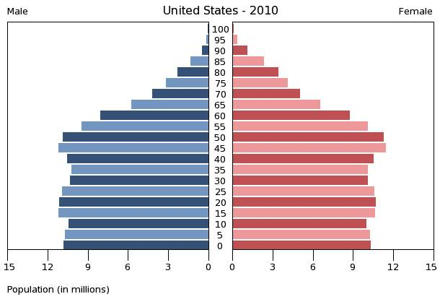
Healthcare Inflation – US Demographics
Courtesy Frank Lexa

Slide 10
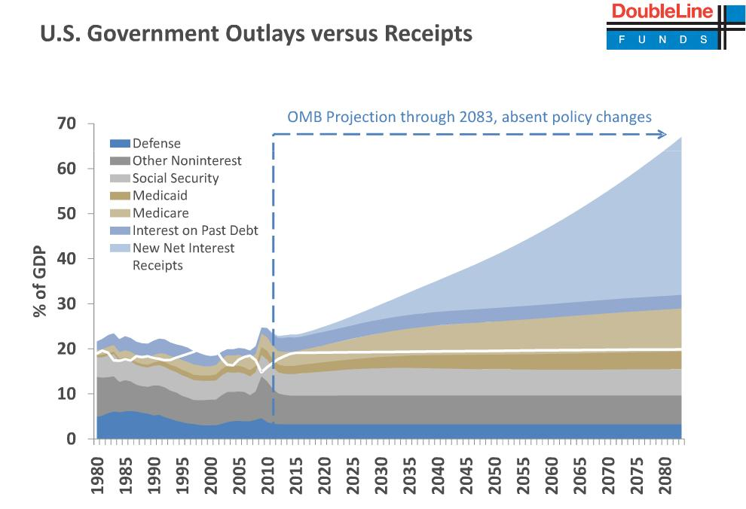
Government Financial Predicament

Slide 11
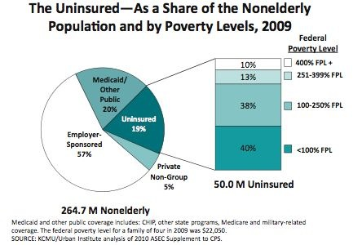
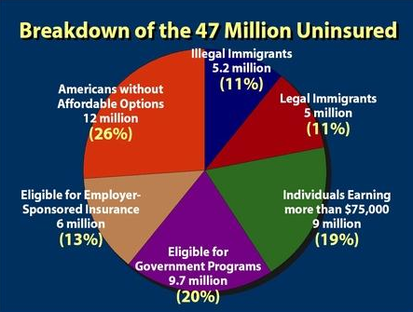
Social Justice

Slide 12
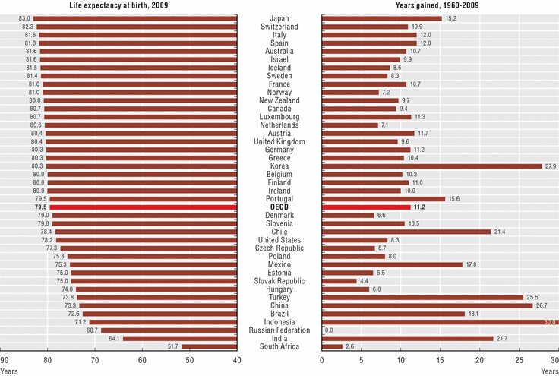
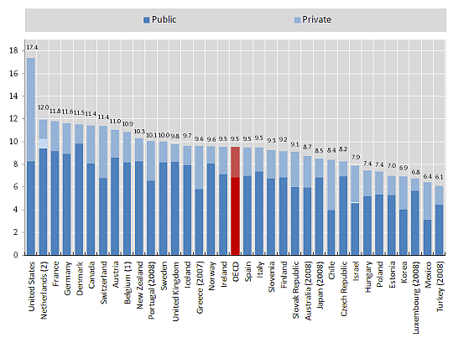
Achieving Value
Courtesy Frank Lexa

Slide 13
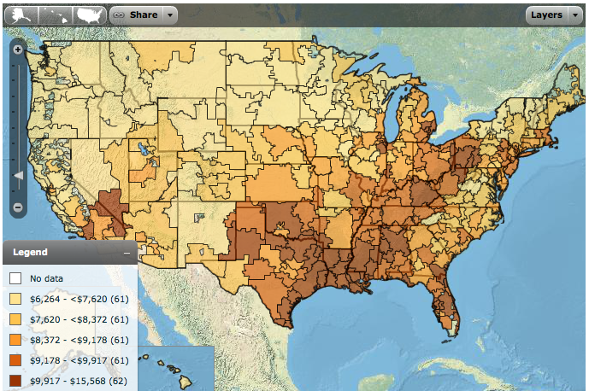
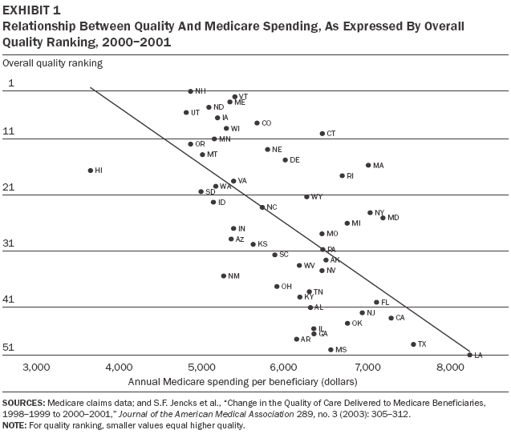
Achieving Value
Courtesy Frank Lexa

Slide 14
Imaging and Health Care Reform
US Healthcare represents 17% of the GDP
Cost is a primary concern for policy makers
CMS exploring Fee-for-Service alternatives
  Episodes of Care: Bundled Payments
  Population Health: Accountable Care Organizations
Shifting of risk from payers to providers
  Extending risk to service lines, such as imaging
  Monitoring and reporting Meaningful Use
Until there are alternative payment systems, FFS payment cuts is the only means to control spending

Slide 15
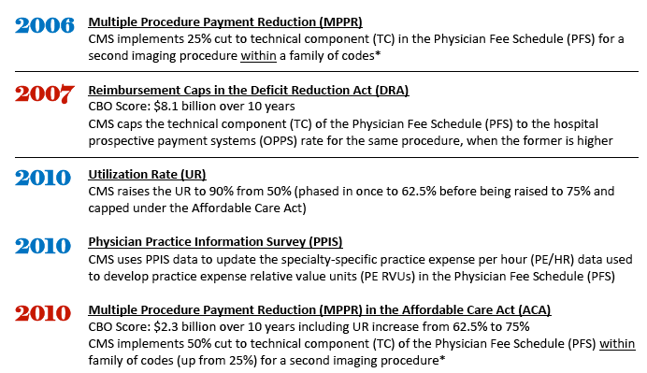
Medical Imaging Payment Reductions
Imaging Payment Cut Twelve Times In Six Years

Slide 16
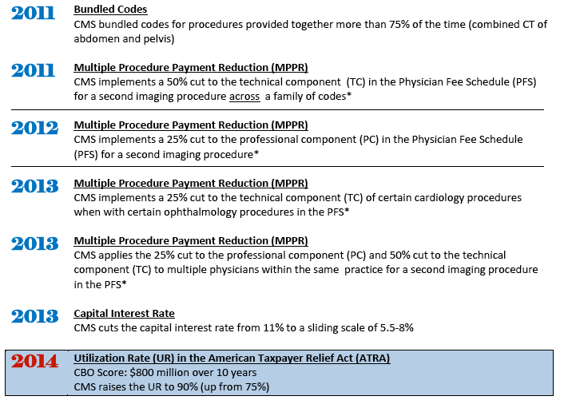
Medical Imaging Payment Reductions

Slide 17
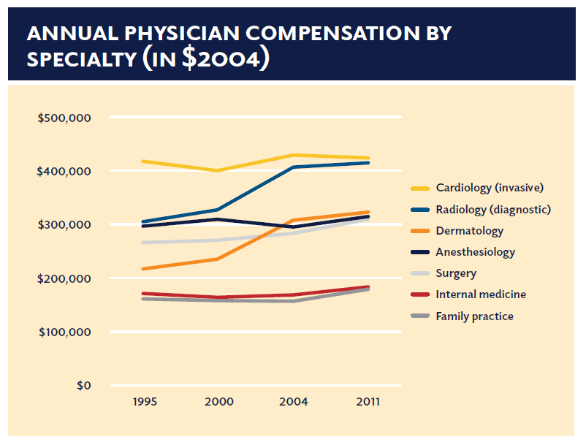
Physician Payments and Primary Care
Closing The Gap Between Specialists and Primary Care
Frist W, et al. Report of NCPPR, 2013.

Slide 18
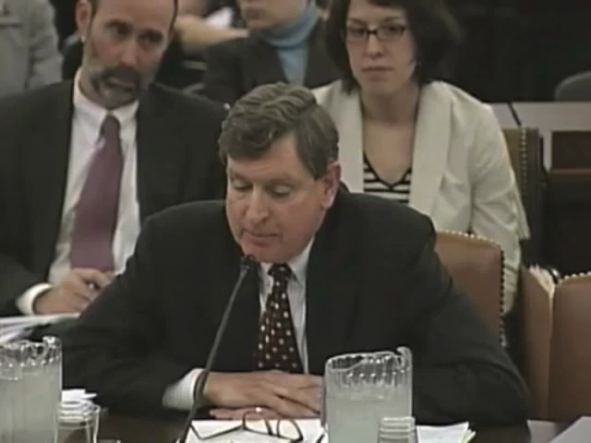
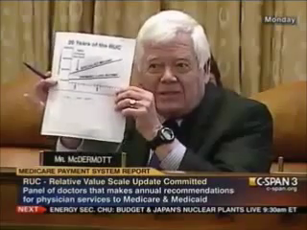
Promoting Primary Care
Flattening Payments To Specialists and Primary Care
MedPAC
Congress
Administration
MedPAC Chairman Hackbarth and Rep. McDermott promote a primary care agenda to Congress

Slide 19
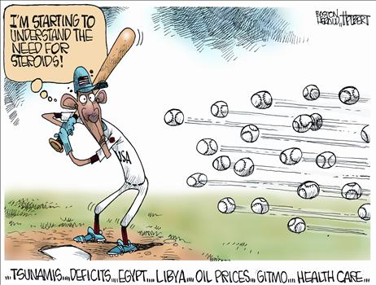
Preserving the Status Quo?
Confronting Congressional and Medicare Payment Policy

Slide 20


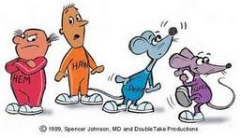
Finding New Cheese!
Notes:
At the AMCLC in 2011 and 2012 in our Economics Session we have used these metaphors from Spencer Johnson's book Who Moved My Cheese?
We have and many other radiology leaders have discussed the imperative of finding new cheese but we continue to Hem and Haw.
In an audience response pool 90% of AMCLC attendees said they believed radiologists and practices would change only when the pain of not changing exceeded the pain of changing
A few are making the trek kike Sniff and Scurry but many are either waiting to see, hoping it goes away or have in the sand or ignorant of what’s ahead…
There will be some physicians who get it and they may well prove very disruptive top those who don’t
Follow Rich Duszak in Twitter for more of these quotes (Do we have our Twitter account?)

Slide 21




Christensen’s Disruptive Innovation
Clayton M. Christensen is the Kim B. Clark Professor of Business Administration at the Harvard Business School, with a joint appointment in the Technology & Operations Management and General Management faculty groups.

Slide 22
Innovator’s Dilemma
Viability & Performance
Status Quo
New Innovation
Time
Adapted from James Reinertsen, “Possible or Passable?”, 2012.

Slide 23
Transition to Value Based Imaging Care
Volume Drives Success
Value Drives Success
Viability & Performance
Time
Adapted from James Reinertsen, “Possible or Passable?”, 2012.

Slide 24
Christensen’s Innovator’s Dilemma
"Generally, disruptive innovations were technologically straightforward, consisting of off-the-shelf components put together in a product architecture that was often simpler than prior approaches. They offered less of what customers in established markets wanted and so could rarely be initially employed there. They offered a different package of attributes valued only in emerging markets remote from, and unimportant to, the mainstream.” Clayton Christensen, 1997
Viability & Performance
Volume Drives Success
Value Drives Success
Imaging’s Current State
Imaging’s Future State
Time
Christensen, Clayton M. (1997), The innovator's dilemma: when new technologies cause great firms to fail, Boston, Massachusetts, USA: Harvard Business School Press, ISBN 978-0-87584-585-2.
Notes:
Many examples of disruptive innovations:
Automobiles replacing trains, CD and DVS replacing floppy drives, Digital media replacing DVDs and CDs, Cloud computing replacing USB drives
Why should we believe that our current payment system is immune to change?

Slide 25
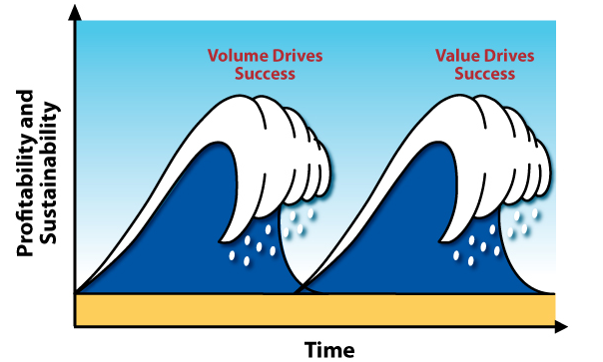
Catching the Next Wave
(Without Getting Stuck In The Trough And Crashing On The Reef)
Notes:
So the rest of this talk is about how radiologists can catch the next wave without getting stuck in the trough

Slide 26


The Big Dilemma
Moving To Value-Based Payment Models
Living In FFS

Slide 27
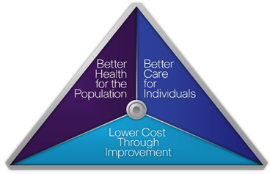
Radiology and Health Reform
Health Reform
The Triple Aim

Slide 28
Strategic Goals for Radiologists
PRESERVING RADIOLOGIST RELEVANCE WHILE IMPROVING PATIENT CARE
Achieve The Imperatives Of Health Reform
Provide better care at lower cost
Improve the health of the population
Empower patients in their health care

Slide 29
Strategic Goals for Radiologists
PRESERVING RADIOLOGIST RELEVANCE WHILE IMPROVING PATIENT CARE
Counter The Threats To Our Profession
Promote practice patterns that increase radiologist relevance
Develop tools that will enhance the value of radiologists to all stakeholders
Provide alternatives to continuing FFS payment cuts

Slide 30

Medical Imaging
Imaging 3.0
Evolution in Patient Care

Slide 31


Medical Imaging
Evolution in Patient Care

Slide 32








Slide 33


Medical Imaging
Evolution in Patient Care

Slide 34
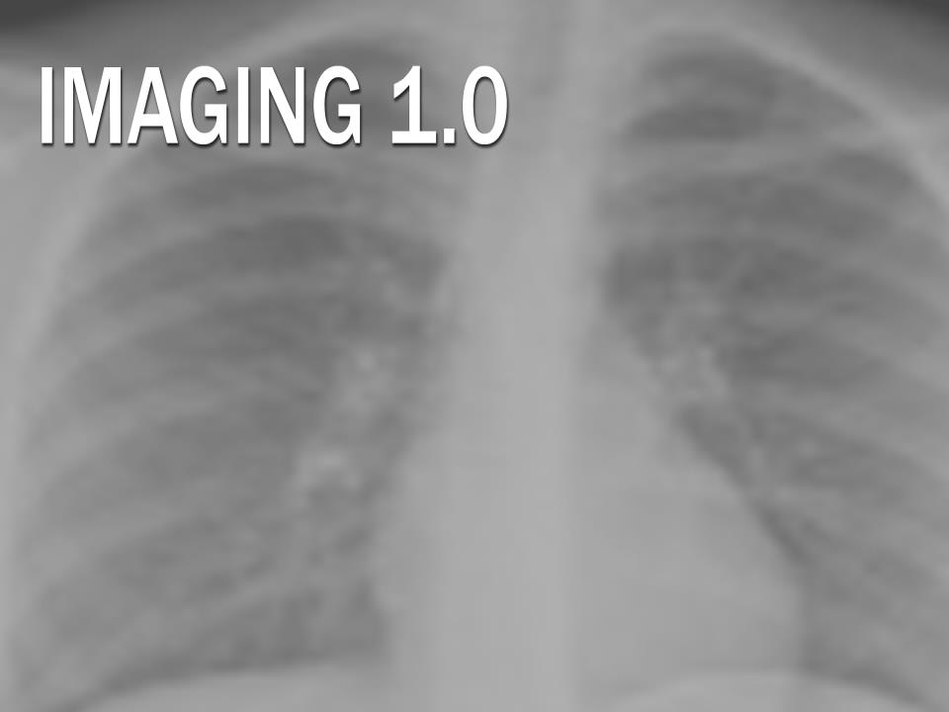


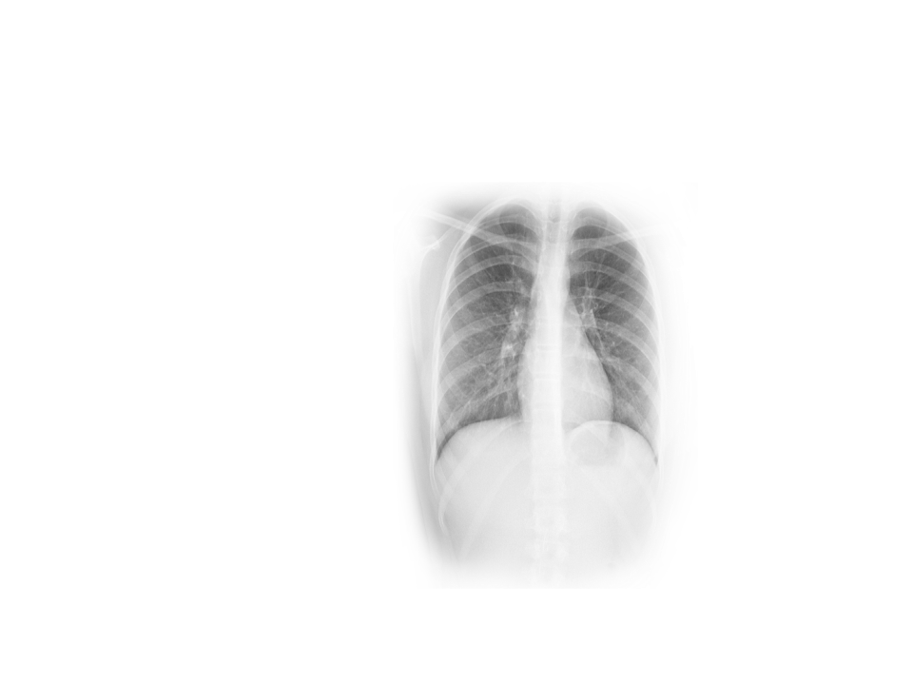

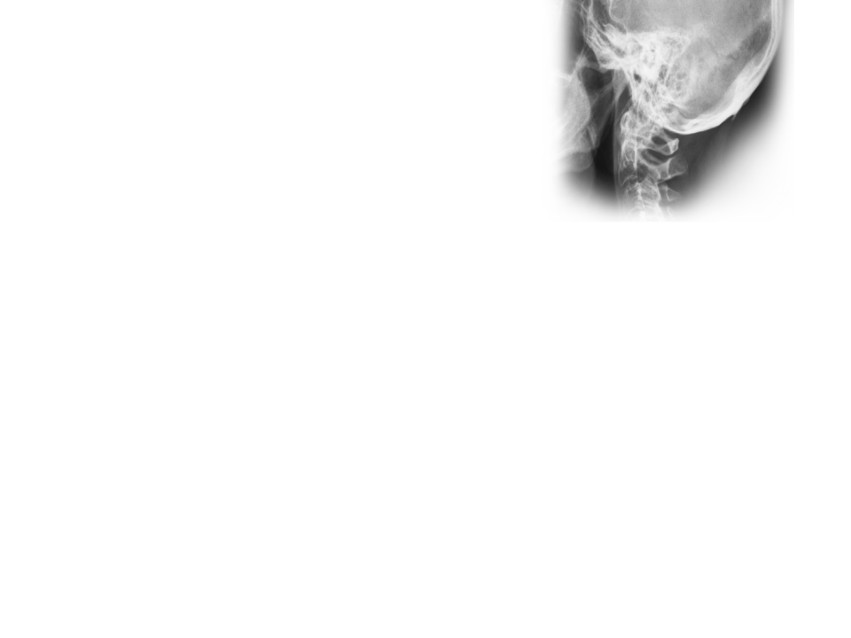


• Physicians
• Contrast Agents
• New Modalities

Slide 35


Medical Imaging
Evolution in Patient Care

Slide 36






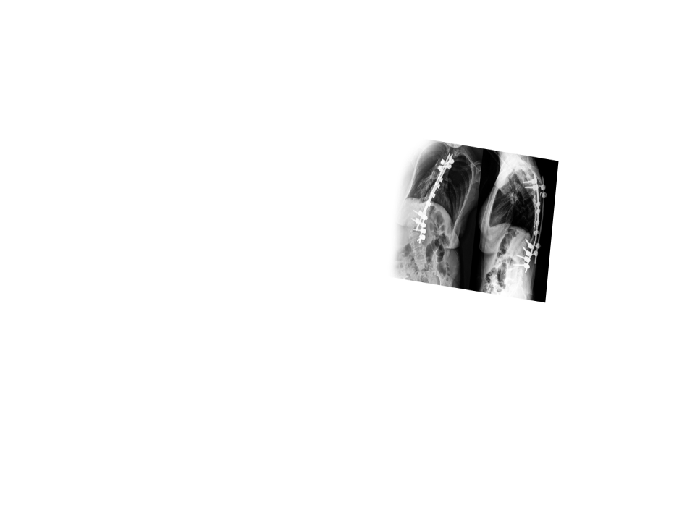

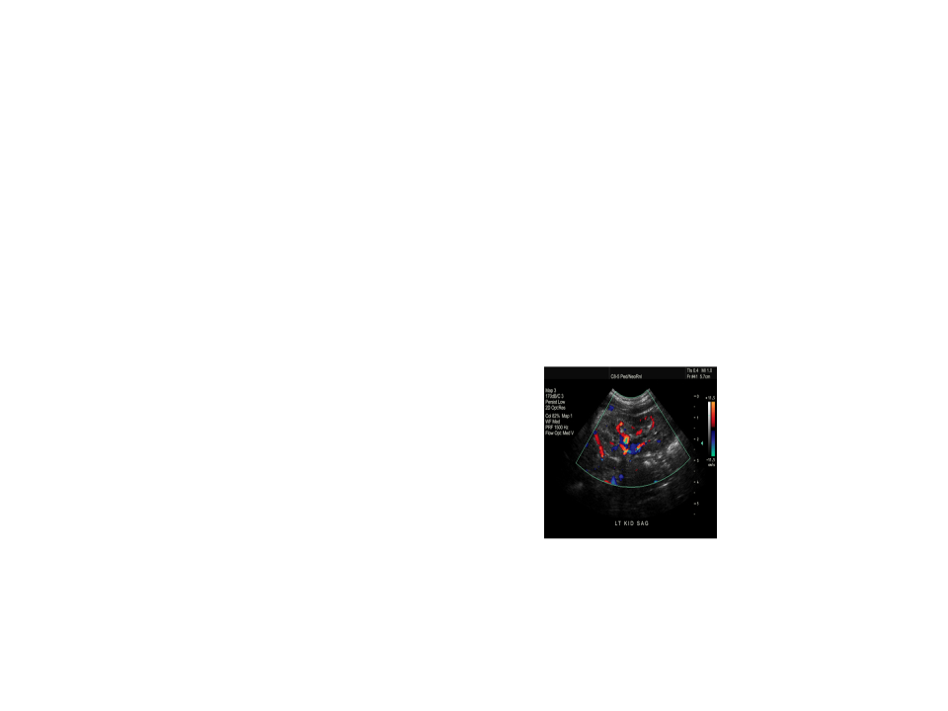


Evolving Modalities
PACS
Knowledge Base
Consultant to Referring Physicians
Unprecedented Demand

Slide 37
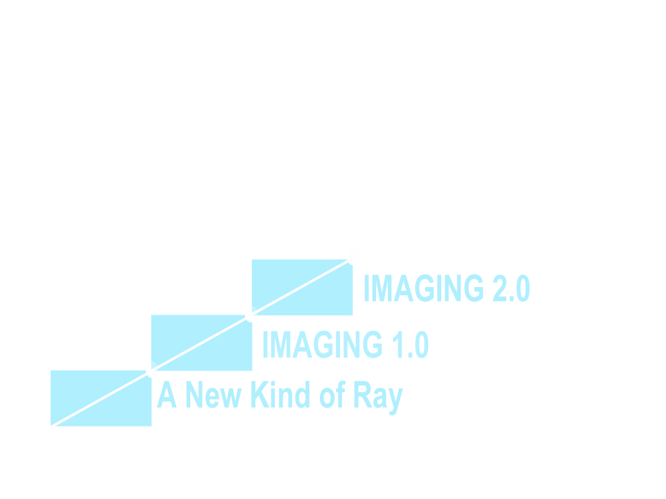

Medical Imaging
Evolution in Patient Care

Slide 38
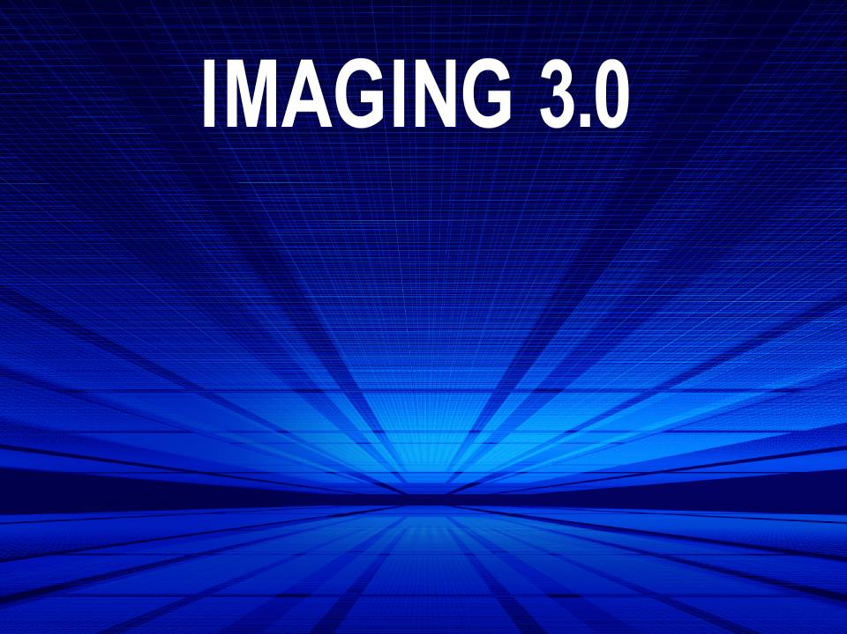



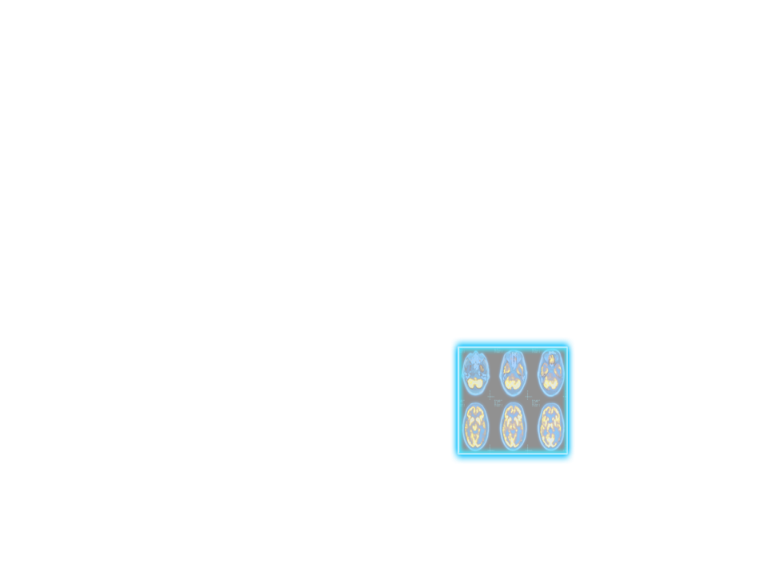
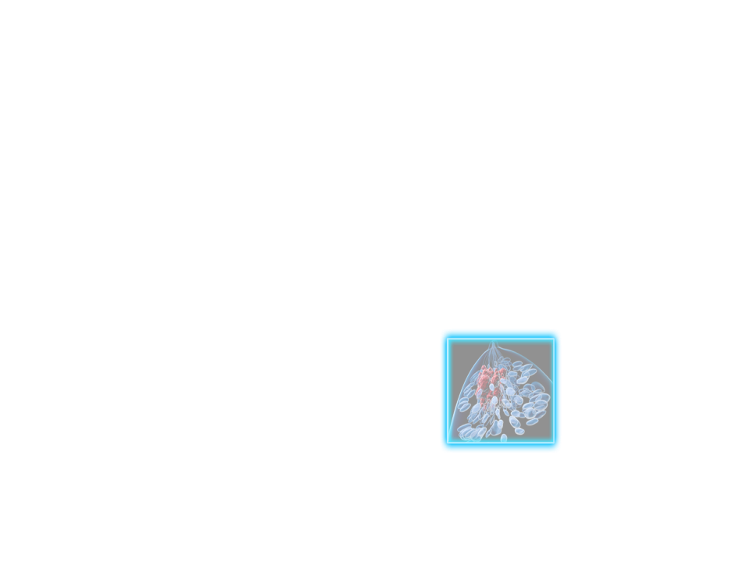
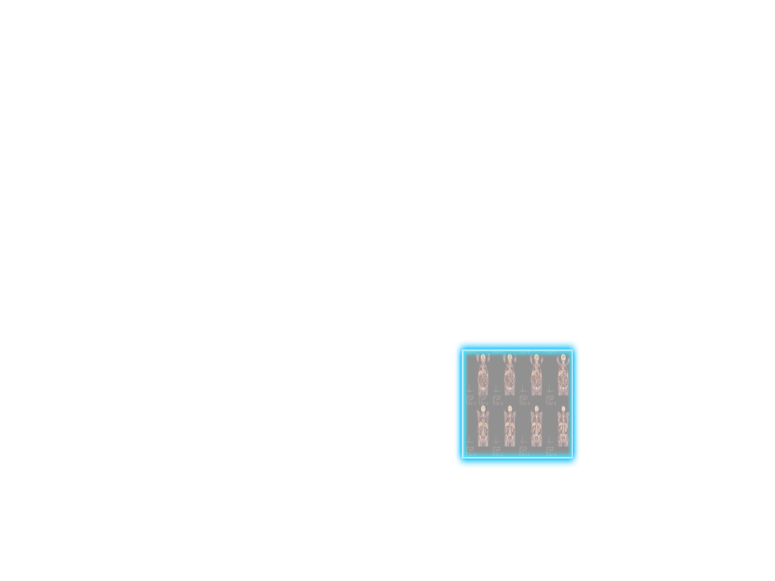
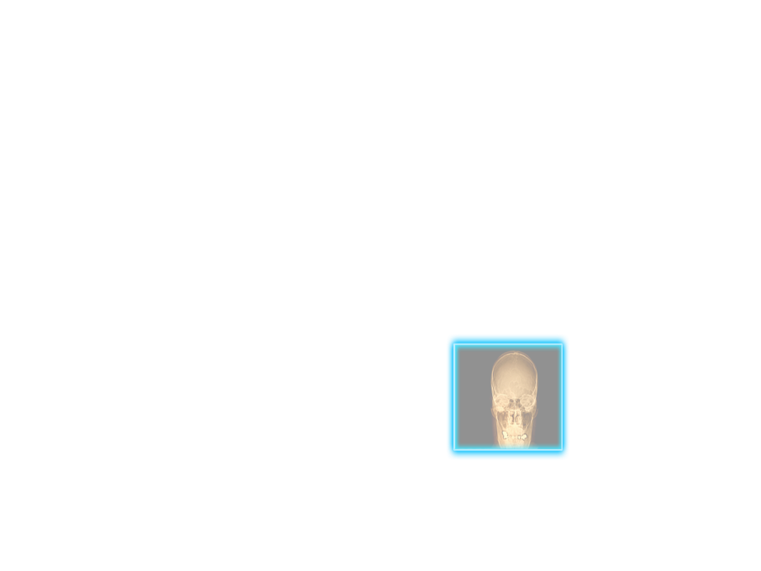




Beyond Interpretations
Assuring Appropriateness
Documenting the Quality and Patient Safety Radiologists Provide
Actionable Reporting with Evidence-based Follow-up Recommendations
Empowered Patients

Slide 39


Slide 40
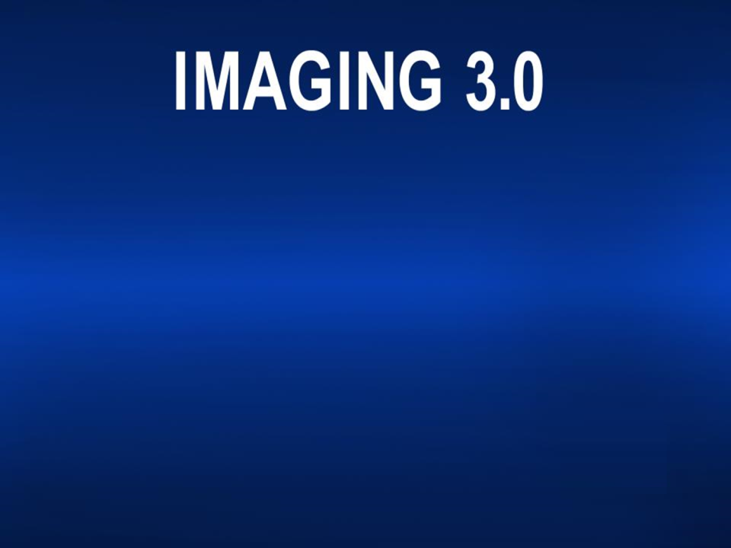
Leveraging radiologists’ tools and expertise to
optimize patient care from the time imaging is
first considered until referring physicians and patients
fully understand the imaging results and recommendations

Slide 41

Maximizing Radiologists’ Value
Collaborating with Other Physicians to Improve Imaging Care
Empowering Patients
Changing the Discussion in Washington

Slide 42
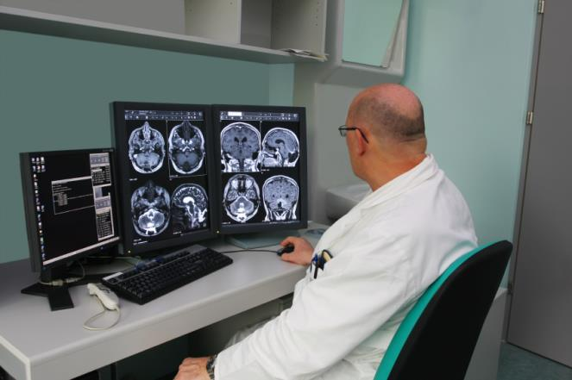
Imaging 2.0
Focus On The Interpretation

Slide 43
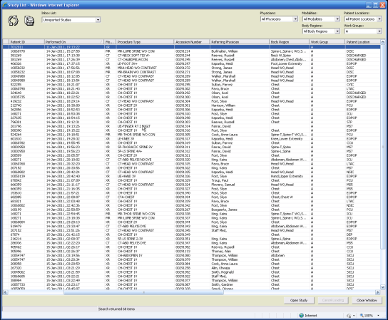
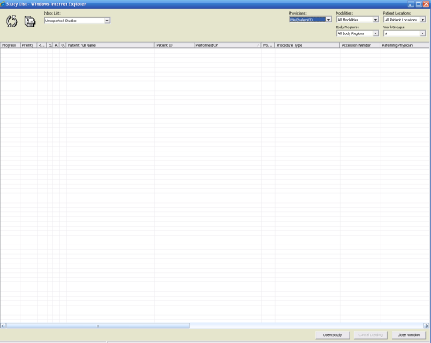
Imaging 2.0 – Radiology Culture

Slide 44


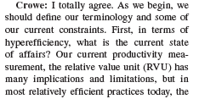
Imaging 2.0 – Radiology Culture
How Do You Improve Your Productivity 40%?
No Interruptions!

Slide 45
Drivers of Imaging 2.0 Culture
Payment models have driven our practice patterns
  Fee-for-service has incentivized volume
  Fee-for-service is neutral on value
Our practice patterns have driven technology development
  Maximizing productivity and volume
  Our technology development has been focused on internally and not optimized for the system or the patients
  Not optimized for reporting performance metrics for quality, safety, access or patient outcomes
Resulting Technologies
  PACS
  Teleradiology

Slide 46
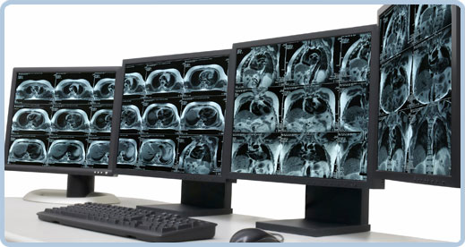
Teleradiology
Access for remote radiologists
  Not designed for regional colleagues
  Not designed for patients
Improve radiologists productivity and convenience
Allowed radiologists to provide subspecialty coverage with in their practices
Unintended consequence
  Potential conduit for commoditization
  Fueled the development of national radiology companies

Slide 47

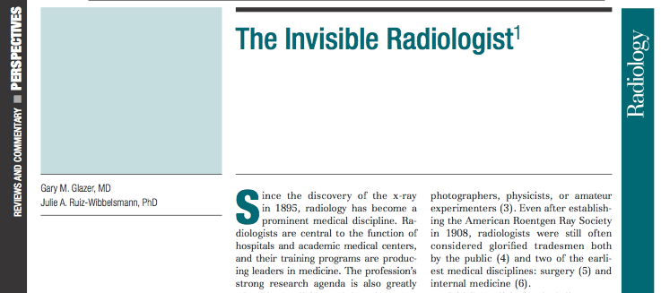
Presence
Relevance
How Radiologists Are Perceived
The public may not realize radiologists are physicians
Other physicians perceive radiologists are underworked and unavailable
Hospital administrators often view radiologists as competitors
Policy makers only hear reimbursement and turf issues

Slide 48

Imaging 2.0: Our Current State
Innovation |  | Productivity | Profitability | Performance | Presence
Current State | RIS |  | ■ | ■ | ■
 | PACS |  |  | ■ | ■
 | Speech Recognition | ■ | ■ | ■ | ■
 | Adv Vis, 3D, CAD |  |  | ■ | 
 | Image Distribution |  | ■ | ■ | 
 | TeleRadiology |  |  | ■ | 
Future State | Image Sharing | ■ | ■ | ■ | 
 | Structured Reporting |  |  |  | 
 | Communication Tech |  | ■ |  | 
 | Imaging CDS |  | ■ |  | 
 | Imaging EHR | ■ | ■ | ■ | ■
 | Imaging PHR | ■ | ■ | ■ | 
Quality
Relevance
Courtesy Keith Dreyer, DO FACR 2013

Slide 49
Evolutionary Perspectives
“It is not the strongest of the species that survives, nor the most intelligent, but the one most responsive to change.”
Charles Darwin
“Physicians who ‘get it’ will prove extremely disruptive to those who do not.”
Richard Afable
“If you don’t like change,
you’ll like irrelevance even less.”
Eric Shinseki

Slide 50

Who is Imaging 3.0 For?
Physicians:
Rads &
Referring
Payers &
Policy
Makers
Patients

Slide 51
What Does Imaging 3.0 Do?
Leverages
IT
Redefines
Productivity
And Value
Establishes
Relationships

Slide 52



Where Does Imaging 3.0 Fit?
Payment
Systems
Radiologist
Relevance
_{Avoid commoditization}
_{Tools for culture shift}
_{Tools for leadership}
_{Fee for service}
_{Risk sharing}
_{Bundled payments}
_{Capitation}
_{Managed Care}
_{ACOs}
Empowered
Patients

Slide 53


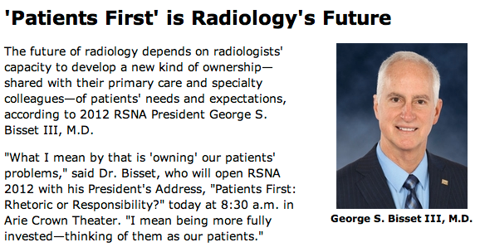
Where Does Imaging 3.0 Fit?
Payers &
Policy
Makers
Systems
Physicians
Patients
“It’s hard to put the patient in the center if you’re sitting there yourself.”
Jim Rawson. MD FACR

Slide 54

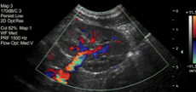

Imaging 3.0 – Beyond the Interpretation
_{Referring Physician}
_{Considers Imaging}
_{Actionable Recommendations}
_{For The Patient And}
_{Referring Physician}
Before Interpretation
After Interpretation
_{Imaging Acquisition}
_{& Interpretation}
Enhancing Image Acquisition and Interpretation

Slide 55
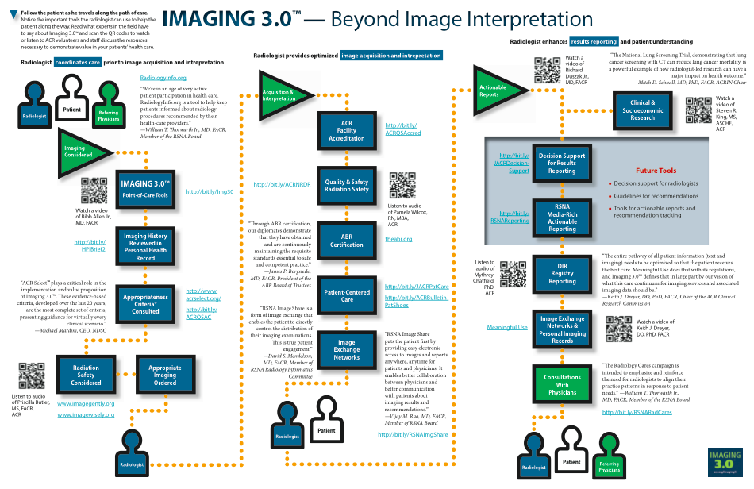

Slide 56




Imaging 2.0 – Focus On the Interpretation
_{Faculty Accreditation}
_{Board Certified}
_{Radiologists}
_{Engage in Lifelong Learning}
Through Maintenance of Certifications
_{Imaging Acquisition}
_{& Interpretation}

Slide 57






Imaging 3.0 – Beyond the Interpretation
_{Referring Physician}
_{Considers Imaging}
_{Imaging Acquisition}
_{& Interpretation}
_{Actionable Recommendations}
_{For The Patient And}
_{Referring Physician}
_{Faculty Accreditation}
_{Board Certified}
_{Radiologists}
_{Engage in Lifelong Learning}
Through Maintenance of Certifications

Slide 58







Imaging 3.0 – Beyond the Interpretation
_{Referring Physician}
_{Considers Imaging}
_{Imaging History}
_{Reviewed in PHR}
_{Appropriateness}
_{Criteria}
_{Consulted}

Slide 59








Imaging 3.0 – Beyond the Interpretation
_{Referring Physician}
_{Considers Imaging}
_{Imaging Acquisition}
_{& Interpretation}
_{Actionable Recommendations}
_{For The Patient And}
_{Referring Physician}
_{Imaging History Reviewed}
_{in PHR}
_{Faculty Accreditation}
_{Appropriateness Criteria}
_{Consulted}
_{Board Certified}
_{Radiologists}
_{Engage in Lifelong}
_{Learning}
_{Through Maintenance}
_{of Certifications}

Slide 60

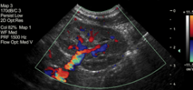


Imaging 3.0 – Beyond the Interpretation
_{Decision Support for}
_{Results Reporting}
_{Actionable Recommendations}
_{For The Patient And}
_{Referring Physician}
_{Media Rich}
_{Actionable Reporting}
_{Registry Reporting}

Slide 61













Imaging 3.0 – Beyond the Interpretation
_{Referring Physician}
_{Considers Imaging}
_{Imaging Acquisition}
_{& Interpretation}
Actionable Recommendations For The Patient And Referring Physician
Imaging History Reviewed in PHR
_{Faculty Accreditation}
_{Decision Support for}
_{Results Reporting}
_{Appropriateness Criteria}
_{Consulted}
_{Board Certified Radiologists}
_{Engage in Lifelong Learning}
Through Maintenance of Certifications
_{Media Rich}
_{Actionable Reporting}
_{Registry Reporting}

Slide 62


Imaging 3.0 – The Entire Spectrum of Imaging Care
_{Referring Physician}
_{Considers Imaging}
_{Imaging Acquisition}
_{& Interpretation}
Actionable Recommendations For The Patient And Referring Physician
Imaging History Reviewed in PHR
_{Faculty Accreditation}
_{Decision Support for}
_{Results Reporting}
_{Appropriateness Criteria}
_{Consulted}
_{Board Certified Radiologists}
_{Engage in Lifelong Learning}
Through Maintenance of Certifications
_{Media Rich}
_{Actionable Reporting}
_{Registry Reporting}

Slide 63



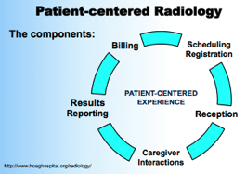



Imaging 3.0 – Putting Patients First
_{Imaging Acquisition}
_{& Interpretation}
_{Imaging Acquisition}
_{& Interpretation}
_{Registry Reporting}
_{Board Certified Radiologists}
_{Engage in Lifelong Learning}
Through Maintenance of Certifications
_{PQRS}
Enhancing Patients’
Experiences
Empowering
Patients
Demonstrating Quality / safety

Slide 64
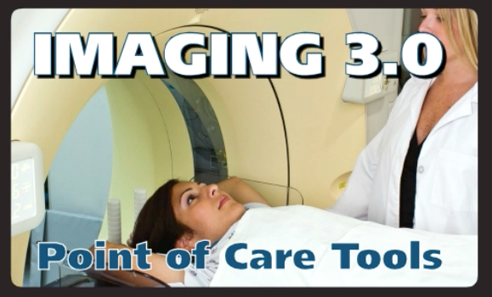






Imaging 3.0 – At The Point of Care
Decision Support for Results Reporting
_{Registry Reporting}
_{PQRS}

Slide 65





















Imaging 3.0 – Under the Umbrella
_{Referring Physician}
_{Considers Imaging}
_{Imaging}
_{Acquisition}
_{& Interpretation}
Actionable Recommendations For The Patient And Referring Physician
Imaging History Reviewed in PHR
_{Faculty Accreditation}
_{Decision Support for}
_{Results Reporting}
_{Appropriateness}
_{Criteria} _{Consulted}
_{Media Rich}
_{Actionable Reporting}
_{Board Certified Radiologists}
_{Engage in Lifelong Learning}
Through Maintenance of Certifications
_{PQRS}
_{Registry Reporting}

Slide 66

Opportunities For Radiologists
Duszak’s Cornerstones For Health Care Reform
Useful
Information
Aligned
Incentives
PATIENTS
Physician
Leadership
Cultural
Support
Courtesy Rich Duszak, MD FACR 2013

Slide 67

Useful Information
“One thing you can't get out of most EMRs is the data you put in there.”
Rick Halton
Usable
Meaningful
  For the patients
  For the system
Not just for radiologists!!

Slide 68

Appropriate Imaging Utilization
4094 Appropriateness Guidelines
800 Clinical Scenarios
114 Clinical Topics
10 Diagnostic
Categories
* As of April 2012

Slide 69


Digitalized And Available Through Web Services
Indications
Procedure
Order Entry
Application
ACR
AC
Appropriateness Rating
Alternatives Procedures
Additional Indications
Relative Radiation Level
ACR AC
Web Services
OR
Clinical Decision Support
Usage Feedback: Selections
Outcomes

Slide 70
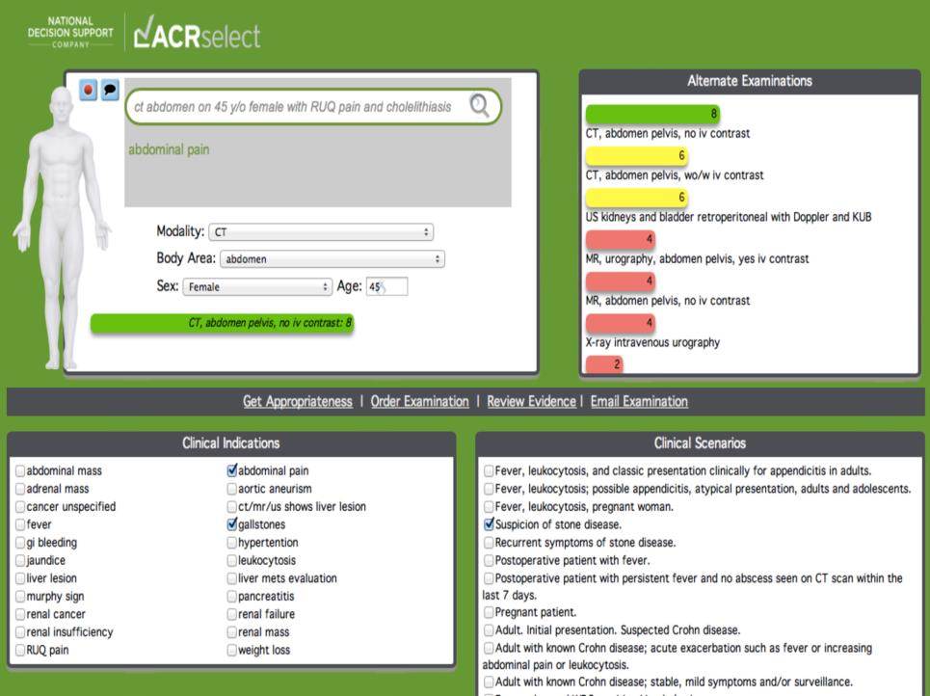




Payers
Collaboration
Ordering
Physician
Consulting Radiologist

Slide 71
Effective Communication
Enhancing communication
  With referring physicians
  With patients
Developing Point Of Care IT Tools
  Actionable findings and recommendations
    Radiologist CDS
    “BI-RADS® - like” recommendations
  Coding the examination
  Interactive multimedia communications
  Access to information

Slide 72
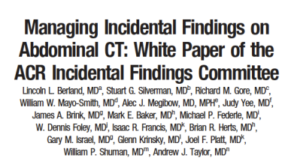
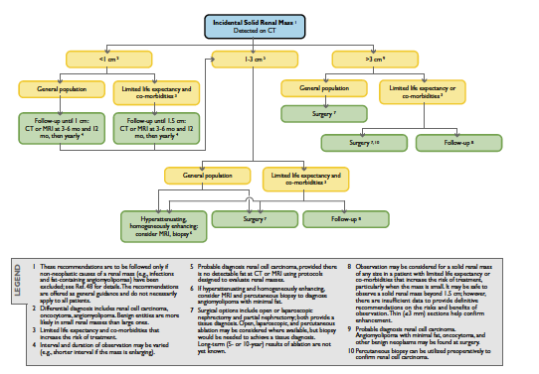

Decision Support for Radiologists

Slide 73
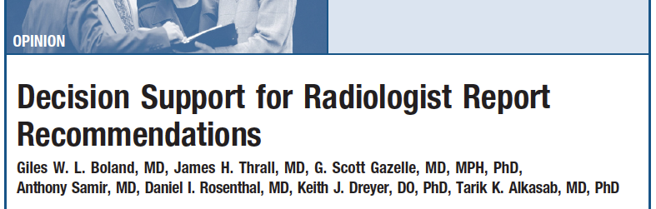
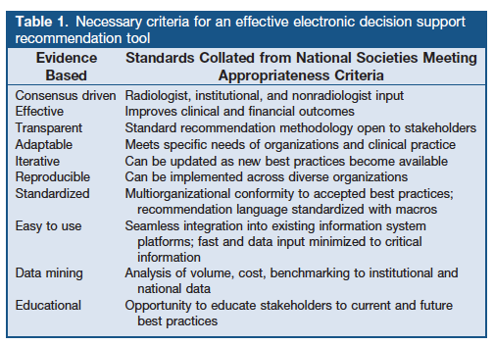

Decision Support for Radiologists

Slide 74
Reporting Pertinent And Incidental Findings
Imaging Findings Alone Do Not Necessitate Further Imaging Or Diagnostic Evaluation
Imaging Findings Alone Indicate The Need For Further Elective Imaging Or Other Diagnostic Evaluation
Imaging Findings Alone Indicate The Need For Further Imaging Or Other Diagnostic Evaluation During The Current Episode Of Care
FURTHER
DIAGNOSTIC EVALUATION
Pertinent Imaging Findings
CHANGE IN CLINICAL MANAGEMENT
No Imaging Findings to Suggest Acute Or Chronic Disease
Imaging Findings Indicate Acute Or Active Disease That May Require A Change In Clinical Management
Imaging Findings Indicate Acute Or Active Disease That Likely require a Significant Or Urgent Change In Clinical Management

Slide 75
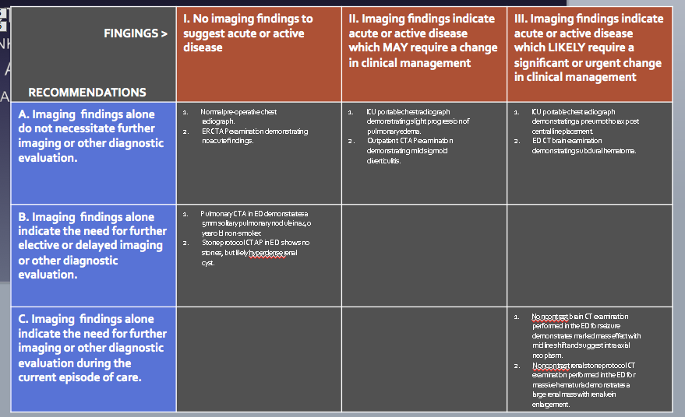
Actionable Reporting

Slide 76
Actionable Reporting Work Group
Work Group Structure
  ACR Communications Guideline
  Structured Reporting
  IT tool development / Vendor relations
  End user radiologists – Academic, General, Young
Work Group Members And Staff
  Paul A. Larson, MD, FACR – Oshkosh, WI – Chair
  Tarik Alkasab, MD – Boston, MA
  Lincoln L. Berland, MD, FACR – Birmingham, AL
  Giles W. Boland, MB, BS, FACR – Boston, MA
  Brent Griffith, MD – Detroit, MI – RFS representative
  Charles E. Kahn, Jr., MD, MS, FACR – Milwaukee, WI
  Lawrence A. Liebscher, MD, FACR – Waterloo, IA
  O. Clark West, MD, FACR – Houston, TX
  Committee Staff
    Colleen Tallant, MS
    Pamela Wilcox, RN, MBA

Slide 77
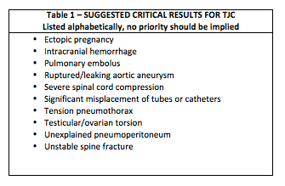
Actionable Reporting Work Group
Categories
  Communicate within minutes – 39 actionable findings
  Communicate within hours – 52 actionable findings
  Communicate within days – 28 actionable
Body Regions
  Neuro
  GI
  GU/OB
  MSK
  Breast
  Chest
  Vascular
  General

Slide 78
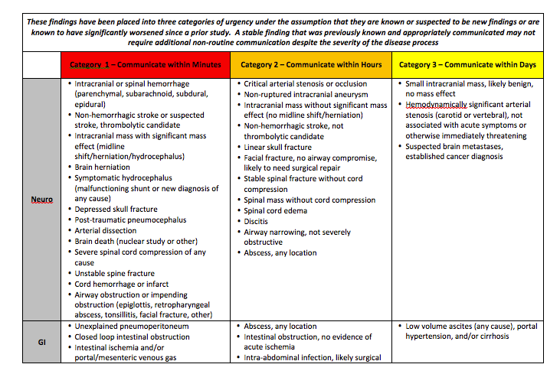
Actionable Reporting

Slide 79
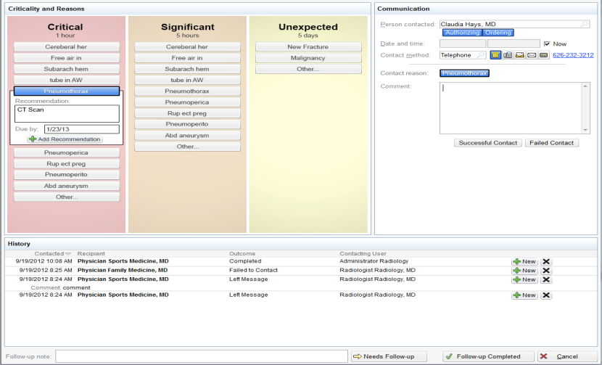
Critical Results Reporting
Courtesy Keith Dreyer DO and Rich Duszak, MD FACR 2013

Slide 80
Tracking Physician Behavior –
Exam Result Versus Appropriateness Score
All Good Physician Behavior
  High Appropriateness Score → Abnormal Exam
  High Appropriateness Score → Normal Exam
  Low Appropriateness Score → Imaging Consult → Normal Exam
Poor Physician Behavior
  Low appropriateness Score → No Imaging Consult → Normal Exam
Opportunity For Education

Slide 81



Interactive Multimedia Reporting
Osirix For iPad

Slide 82

Access to Information
Health Information Exchanges
EHR
EHR
EHR
Patients
Imaging Health Record
RIS
PACS
PACS
Image
sharing
Imaging Information Exchanges
Source: RadiologyMU.org

Slide 83

Access to Information

Slide 84

ACR←→ RSNA Collaboration
INFORMATICS

Slide 85

INFORMATICS ACTIVITIES
Before Imaging

Slide 86

INFORMATICS ACTIVITIES
Image Acquisition And Interpretation

Slide 87

INFORMATICS ACTIVITIES
After Imaging
Notes:
Remember to say that the result of collaboration and the organization of the activities around Imaging 3.0 allowed the IT group to see the holes and start looking for what we can do to provide these tools – especially patient centered care

Slide 88

INFORMATICS ACTIVITIES
Multiple Societies And Organizations
Competition To Collaboration
Notes:
Remember to say that the result of collaboration and the organization of the activities around Imaging 3.0 allowed the IT group to see the holes and start looking for what we can do to provide these tools – especially patient centered care

Slide 89
Imaging 2.0 → Imaging 3.0
Innovation |  | Productivity | Profitability | Performance | Presence
Current State | RIS |  | ■ | ■ | ■
 | PACS |  |  | ■ | ■
 | Speech Recognition | ■ | ■ | ■ | ■
 | Adv Vis, 3D, CAD |  |  | ■ | 
 | Image Distribution |  | ■ | ■ | 
 | TeleRadiology |  |  | ■ | 
Future State | Image Sharing | ■ | ■ | ■ | 
 | Structured Reporting |  |  |  | 
 | Communication Tech |  | ■ |  | 
 | Imaging CDS |  | ■ |  | 
 | Imaging EHR | ■ | ■ | ■ | ■
 | Imaging PHR | ■ | ■ | ■ | 
Courtesy Keith Dreyer, DO FACR 2013

Slide 90
Aligning Incentives
“Call it what you will, incentives are what get people to work.”
Nikita Khrushchev
“Health care won't be simplified until complexity is not so profitable.”
Dr. Rob Lamberts

Slide 91





Imaging 3.0 – Aligning Incentives
Misaligned Payment Systems Incentives
No incentives to reduce volume in fact in most cases traditional productivity may decrease
No reward for the work of assuring only appropriate care is provided
Not all practices will be ready at the same time
Not all systems will be ready at the same time
Radiology’s Voice In Washington

Slide 92



Aligning Incentives
Policy Maker
Buy In
Public Policy Changes
Clinician
Buy In
Radiologist
Buy In
Improved Patient Care
Physicians Change Their Behavior
Courtesy Keith Dreyer, DO FACR 2013

Slide 93

Physician Leadership
Hospitals ranked in the top 100 for cancer, digestive and cardiovascular care by U.S. News & World Report were more likely to be led by physicians than by business or other health care professionals
Quality scores of hospitals led by physicians received were 25% higher than those headed by CEOs with only a business background
“No problem can be solved from the same level of consciousness that created it.”
Albert Einstein
“Consensus is the enemy
of innovation.”
Clay Johnson

Slide 94







Solutions May Be Counterintuitive
Provide value not volume
Redefining productivity
Management
Communication
Leadership
Wag Dodge
Notes:
Forrest Service Smokejumpers
Commonwealth Fund

Slide 95


Patient Centered Imaging Care
ACR-RSNA Imaging 3.0 – Radiology Cares Collaboration
  RSNA Radiology Cares
    Alignment of radiology practice with patients’ needs and best interests
    Optimal patient experience throughout the continuum of their radiologic care.
    Effective communications with patients and other healthcare providers, thus empowering patients to make informed decisions regarding their medical care.
Special Focus Session

Slide 96
Patient Centered Imaging Care

Slide 97
Applying IT To Practice – Next Steps
Patients
Tools to modify schedule examinations
Tools to access Exam Details, Preps, Directions
Tools to access images and reports (cloud-based)
Tools to interact with interpreting radiologist

Slide 98

The Imaging 3.0 Tipping Point

Slide 99
ACR Initiatives To Reach The Tipping Point
CMMI Grant
Imaging 3.0 Website expansion – Marketing and ACR Press
Imaging 3.0 Reading Room – JACR and ACR Press
Imaging 3.0 Case studies – ACR Press
  12 completed
  15+ case studies in pipeline
  Soliciting new case studies using web site and ACR Advocacy Networks
Imaging 3.0 Integration in RLI Programming (RLI)
  Imaging 3.0 Webinar
  Culture shift
  Practice Management – Business Model (ACR Economics and NDSC)
Imaging 3.0 Speaker Bureau in development
Economics Initiatives (ACR Economics and GR)
Notes:
Imaging 3.0 Website expansion – Marketing and ACR Press
Imaging 3.0 Reading Room – JACR and ACR Press
Imaging 3.0 Case studies – ACR Press
12 completed
15+ case studies in pipeline
Soliciting new case studies using web site and ACR Advocacy Networks
Imaging 3.0 Integration in RLI Programming (RLI)
Imaging 3.0 Webinar
Culture shift
Practice Management – Business Model (Mike Mardini and NDSC)
Imaging 3.0 Speaker Bureau (Building on existing infrastructures of RLI, state chapter protal, chapter visitation program)
Economics Initiatives (ACR Economics and GR)

Slide 100
Messaging Imaging 3.0 –
CMMI Grant Application: Imaging 3.0 Care Network
“I3CN would yield huge cost savings on the order of approximately $6.3 billion annually on a national basis for CMS if it became a best practice, or $21.6 billion annually for the U.S. health care system.”
“I3CN is built on the principles of ACR’s Imaging 3.0 initiative, a medical imaging delivery model that shifts volume-based care to value-based care, sparking the need for aligned payment incentives that match this new workflow.”

Slide 101



Messaging Imaging 3.0 –
Imaging 3.0 Case Studies

Slide 102






Imaging 3.0 Umbrella
Radiologists
Policy
Makers
Health Care
Industry
Other Providers
Technology Vendors
Other Payers

Slide 103

The Future Of Imaging Care

Slide 104

Imaging 3.0 – Preparing for the Future

