Slide 1
Imaging 3.0: A Framework for Radiologists’ Future
Speaker Name Date
Notes:
We are here today to talk about a concept called Imaging 3.0 that has been put forth by the American College of Radiology.
Imaging 3.0 is more than an initiative of the ACR. It is a critical framework for the future of radiology—one that involves all radiologists, support professionals, IT teams, and vendors.
Simply put, Imaging 3.0 brings together the information and tools to create a framework that will help the radiology community navigate the transition from volume-based care to value-based care.

Slide 2
Imaging 3.0: An Overview
Optional: Embed video clip of Dr. Geraldine McGinty here.
Notes:
Before we get started, I’d like to play a short video introduction of Imaging 3.0 by the ACR’s Chair of the Economics Commission, Dr. Geraldine McGinty.

Slide 3
Medical Imaging
Imaging 3.0
Evolution in Patient Care
Notes:
So right now, you are probably asking yourself:
-Why is this the third generation of our specialty?
-Why is this considered a new era in the practice of radiology?
I’m glad you asked. Let’s take a quick look at the evolution of imaging and why we are on the brink of a new era in imaging care.

Slide 4
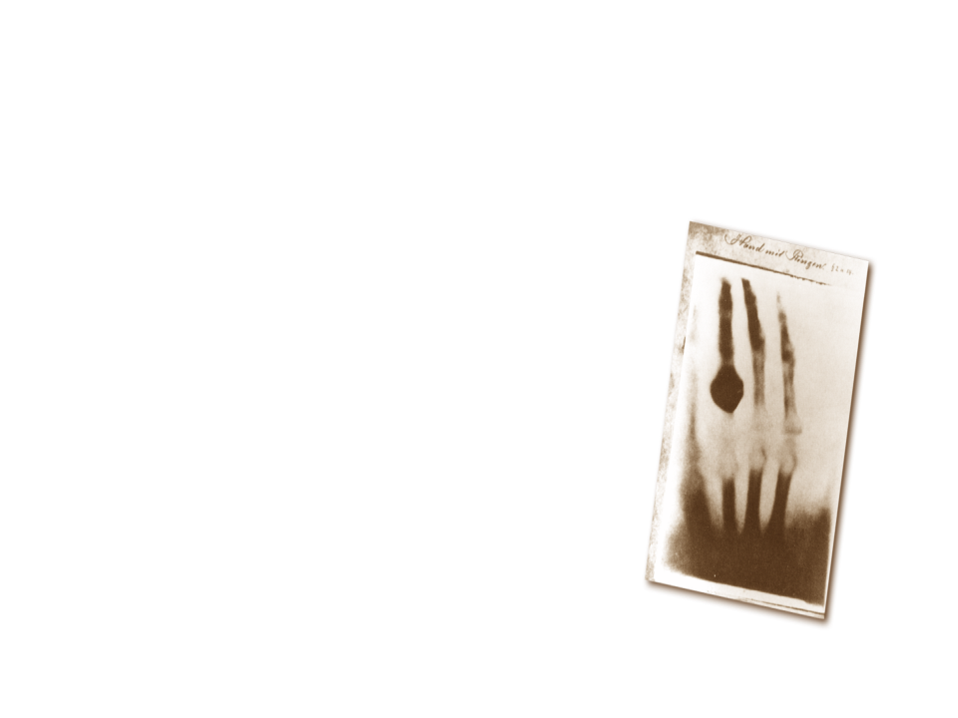
Notes:
It all started with a new kind of ray. In the late 1800s, Wilhelm Roentgen first produced and detected electromagnetic radiation in a wave length now known as X-rays. Initially, this new kind of ray was used in sideshows and for photography. Gradually, X-rays began being used for medical applications.

Slide 5
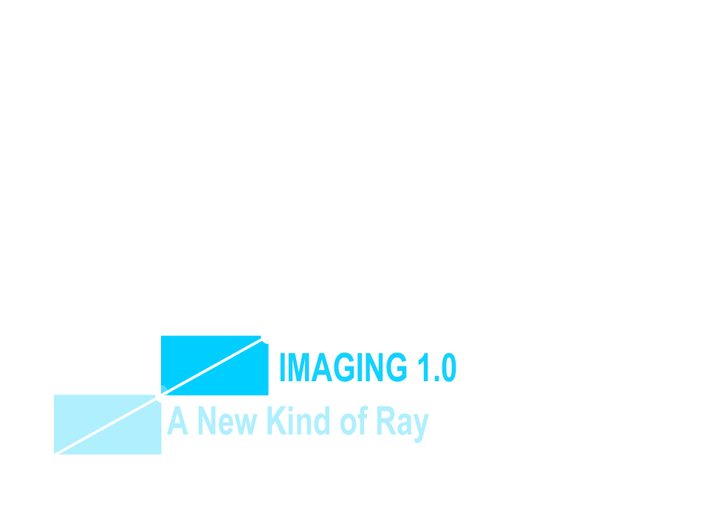
Medical Imaging
Evolution in Patient Care
Notes:
Then came what we call Imaging 1.0…

Slide 6
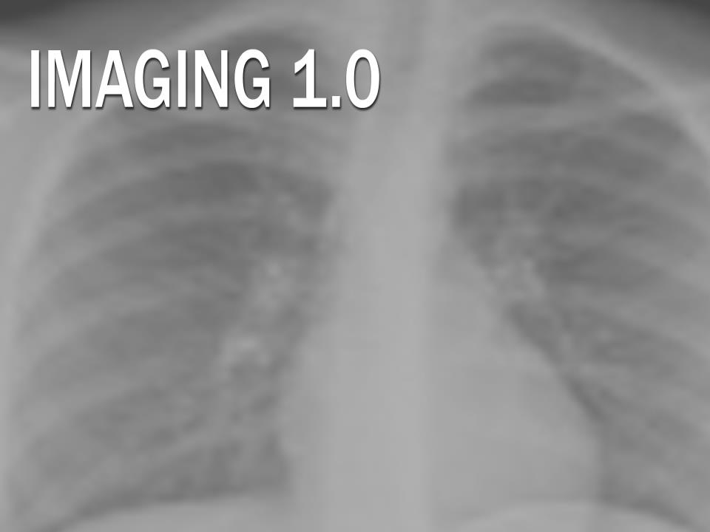
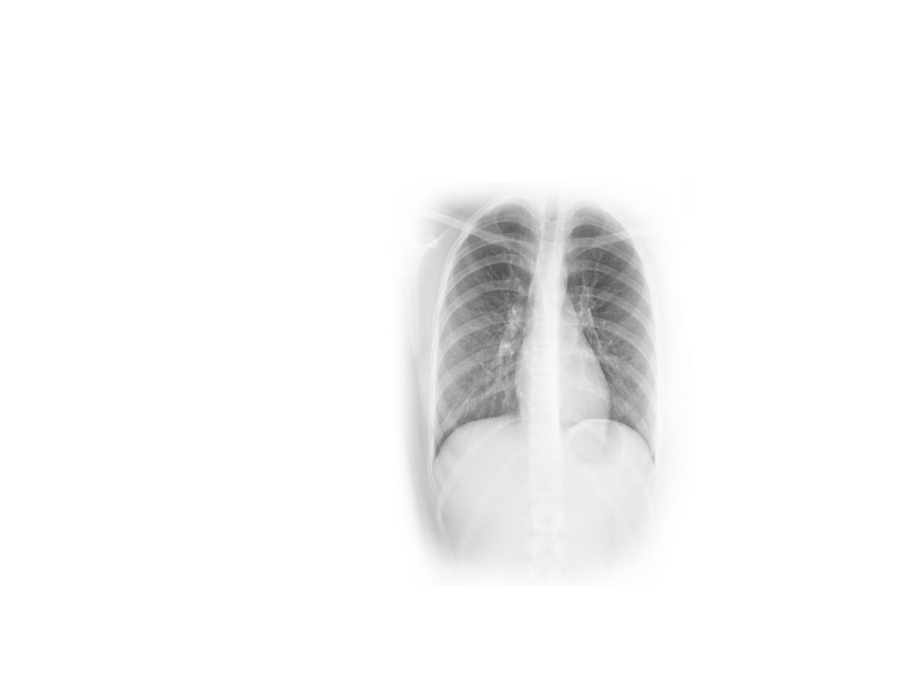
• Physicians
• Contrast Agents
• New Modalities
Notes:
In this first generation of medical imaging, physicians began embracing this capability to diagnose and treat patients. We developed new contrast agents and new modalities. Imaging 1.0 lasted from 1920 to 1990.

Slide 7
Medical Imaging
Evolution in Patient Care
Notes:
In 1990, we moved into the next-generation of imaging…Imaging 2.0

Slide 8
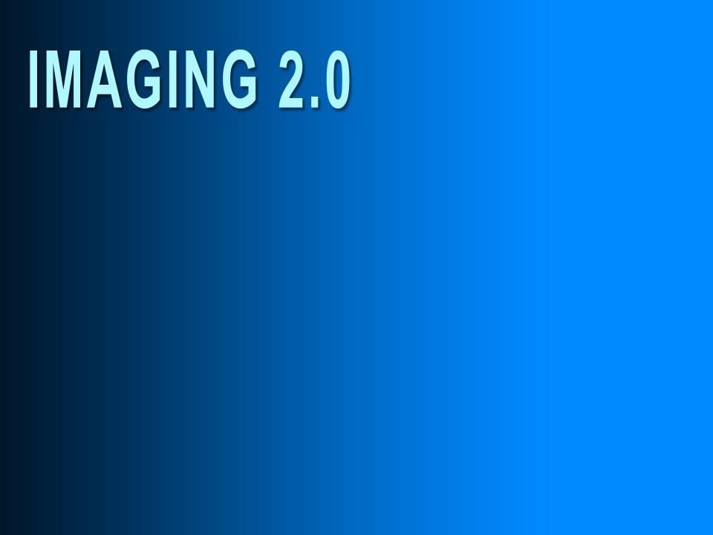
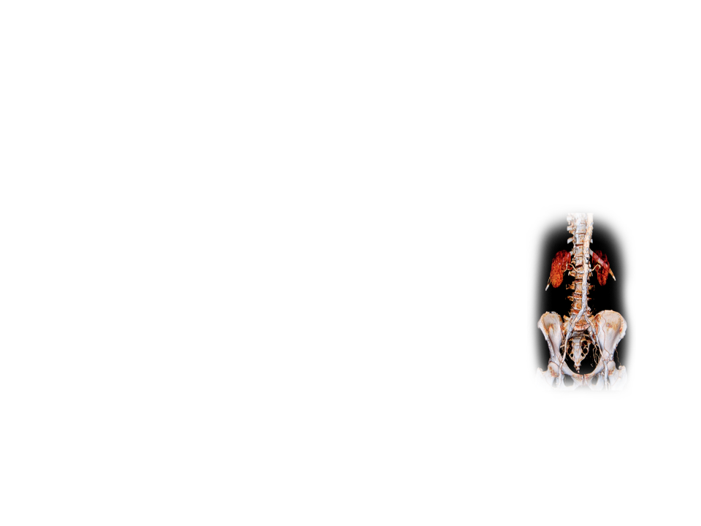
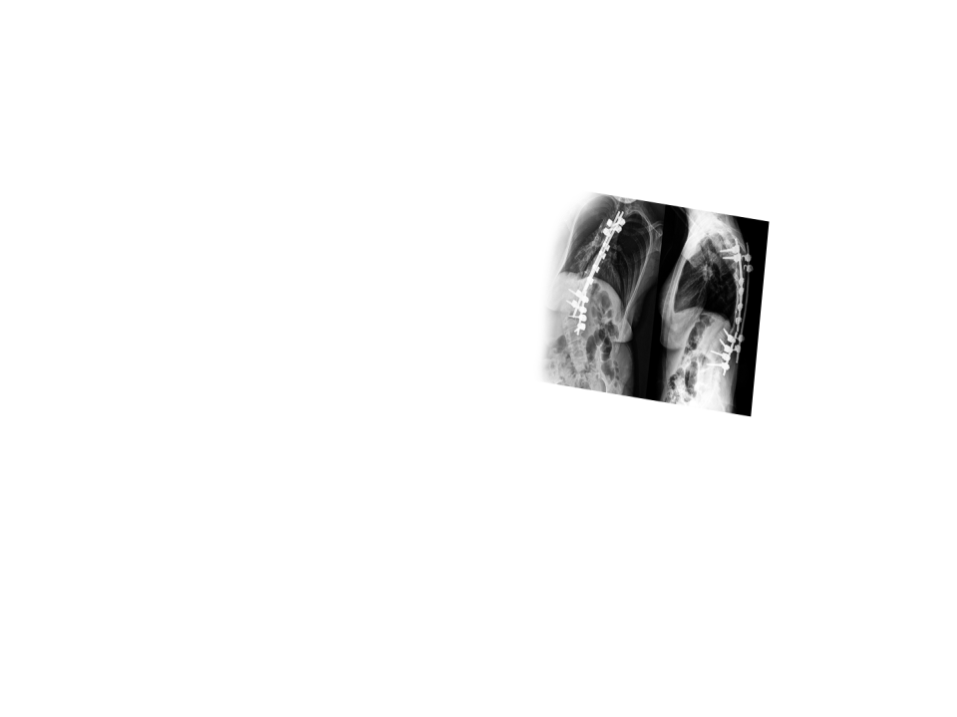
Evolving Modalities
PACS
Knowledge Base
Consultant to Referring Physicians
Unprecedented Demand
Notes:
Imaging 2.0 has been characterized by an explosion of technology. We have more new modalities than ever before. We have seen the advent of PACS and expanding knowledge bases. Radiologists became consultants to referring physicians. We saw unprecedented demand for what we do, and we became indispensible to the health care model.
But now things are changing again…

Slide 9
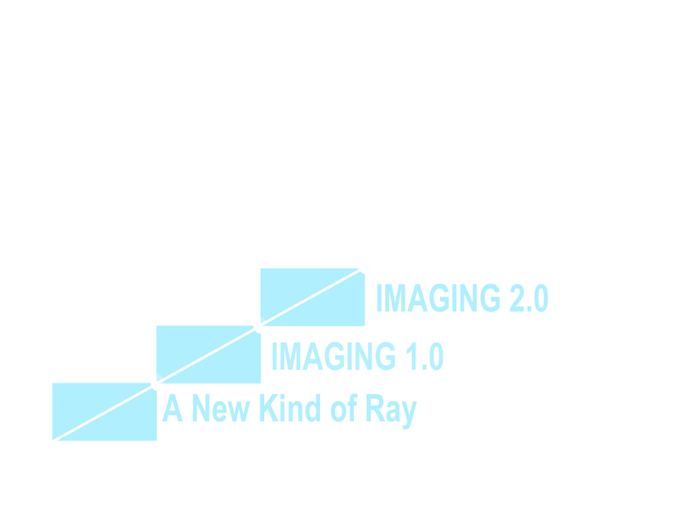
Medical Imaging
Evolution in Patient Care
Notes:
Today we are on the leading edge of an new era in imaging…Imaging 3.0. This is an era in which radiologists must move beyond interpretation, redefine our business model, and re-establish our relevance within the health care system.

Slide 10
Beyond Interpretations
Assuring Appropriateness
Documenting the Quality and Patient Safety Radiologists Provide
Actionable Reporting with Evidence-based Follow-up Recommendations
Empowered Patients
Notes:
What exactly is Imaging 3.0?
Imaging 3.0 is our framework for the future of radiology. It is our blueprint for providing high-value care. As we move beyond interpretation, we must:
Assure that what we do is appropriate.
Document our quality and safety.
Ensure actionable ways to report our results and evidence-based recommendations.
We must empower our patients.

Slide 11
Maximize radiologists’ value
Collaborate with other physicians to improve imaging care
Empower patients
Change the discussion in Washington
Notes:
The goals of Imaging 3.0 are to:
Maximize radiologists’ value
Collaborate with other physicians to improve imaging care
Empower patients
Change the discussion in Washington

Slide 12
Leveraging radiologists’ tools and expertise to optimize patient care from the time imaging is first considered until referring physicians and patients fully understand the imaging results and recommendations.
Notes:
Along the way, we must work to leverage radiologists’ tools and expertise to optimize patient care from the time imaging is first considered until referring physicians and patients fully understand the imaging results and recommendations.

Slide 13
What’s Driving Imaging 3.0?
Notes:
Let’s talk a little about what’s driving the shift to a new generation of radiology. There are three primary drivers to move us to Imaging 3.0:
Health care reform
Gap in costs between specialist payments and primary care
Our current imaging culture

Slide 14
Health Care Reform
US health care represents 17% of the GDP
Cost is a primary concern for policy makers
CMS is exploring fee-for-service (FFS) alternatives
Episodes of Care: Bundled Payments
Population Health: Accountable Care Organizations
Shifting risk from payers to providers
Extending risk to service lines, such as imaging
Monitoring and reporting Meaningful Use
Until there are alternative payment systems, FFS payment cuts are the way to control spending.
Notes:
These pressures are not news to most radiologists. Policy makers are looking at things like new payment models, population health, and Accountable Care Organizations. Cost is a primary concern for policy makers right now.
In fact, imaging payments have been cut 12 times in the last six years—with more cuts projected in 2014.

Slide 15
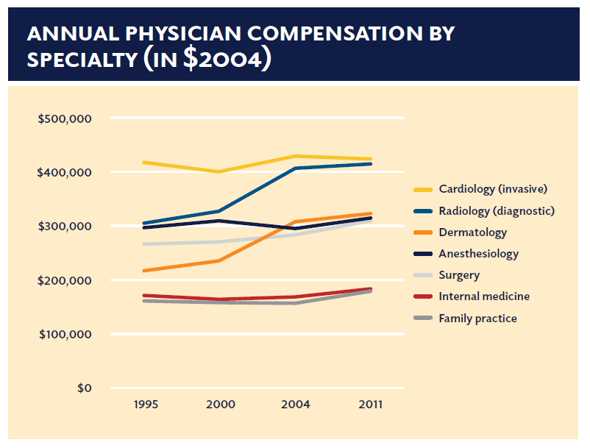
Specialist Payments vs. Primary Care
Frist W, et al. Report of NCPPR, 2013.
Notes:
One of the reasons the imaging profession has been a prime target for cuts is due to gaps in physician compensation.
Policy makers are looking at ways to close the rising cost gap between primary care and the top specialties. They are asking: Do radiologists really provide that much additional value?
Of course, we think we do, but we need to figure out how to demonstrate it and how to align our incentives as we shift our culture from volume-based success to value-based success.

Slide 16
Our Current Imaging Culture
Payment models have driven our practice patterns
Fee-for-service has incentivized volume
Fee-for-service is neutral on value
Our practice patterns have driven technology development
Maximizing productivity and volume
Notes:
If you look at our current culture, you will see that our payment models are driving the way we practice. FFS provides incentives for more volume…and is neutral on value.
We can promote our value, but FFS doesn’t drive it.
Our practice patterns have driven us to maximize our productivity and volume.
And technology has supported that push to productivity.

Slide 17
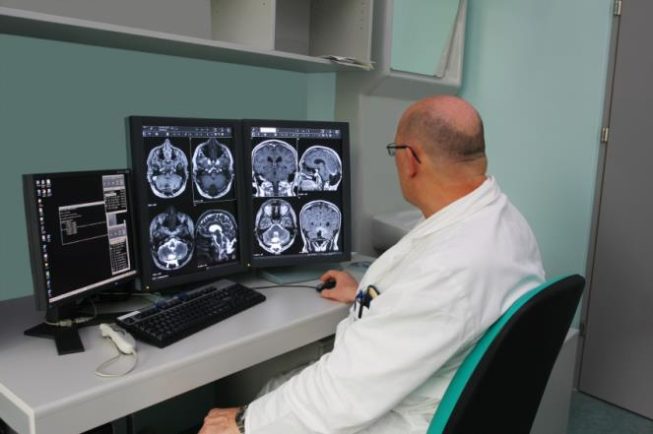
Technology Tools
Focus On The Interpretation
Notes:
Under our current Imaging 2.0 culture, our technology development has been focused internally to help radiologists’ productivity
Not optimized for the system or the patients
Not optimized for reporting performance metrics for quality, safety, access, or patient outcomes
The technologies that emerged under Imaging 2.0 are:
PACS, which have greatly improved radiologists’ productivity; and
Teleradiology, which provides access for remote radiology
Unfortunately, teleradiology has proven to be a two-edged sword. It is not really being used for regional coverage or for patient care; it is mostly being used for radiologists’ convenience.
But there have been unintended consequence:
Potential conduit for commoditization
Fueled the development of national radiology companies
All of which has seriously impacted our relevance.

Slide 18
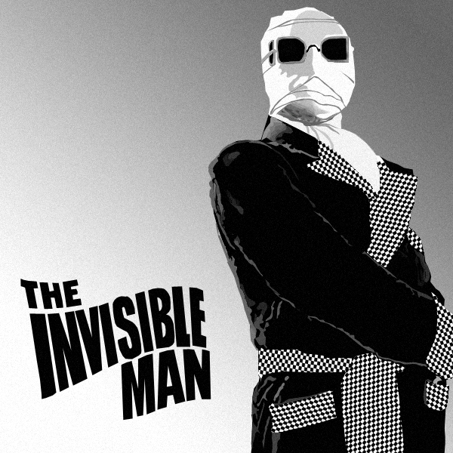
Presence
Relevance
How Radiologists Are Perceived
The public may not realize radiologists are physicians
Other physicians perceive radiologists are underworked and unavailable
Hospital administrators often view radiologists as competitors
Policy makers only hear reimbursement and turf issues
Notes:
If you look at how radiologists are perceived today, there are several noteworthy perceptions to consider:
The public may not even realize we are physicians. In fact, many people think the technician who performs their scan is the radiologist.
Other physicians may hold the perception that we are “underworked, overpaid, and unavailable.”
Hospital administrators may wonder if we are aligned with their interests. They might even see local radiology centers trying to compete with the hospital.
Policy makers only hear us complain about self-referral and cuts to our pay.

Slide 19
Imaging 2.0: Our Current State
Innovation |  | Productivity | Profitability | Performance | Presence
Current State | RIS |  | ■ | ■ | ■
 | PACS |  |  | ■ | ■
 | Speech Recognition | ■ | ■ | ■ | ■
 | Adv Vis, 3D, CAD |  |  | ■ | 
 | Image Distribution |  | ■ | ■ | 
 | TeleRadiology |  |  | ■ | 
Future State | Image Sharing | ■ | ■ | ■ | 
 | Structured Reporting |  |  |  | 
 | Communication Tech |  | ■ |  | 
 | Imaging CDS |  | ■ |  | 
 | Imaging EHR | ■ | ■ | ■ | ■
 | Imaging PHR | ■ | ■ | ■ | 
Quality
Relevance
Courtesy Keith Dreyer, DO FACR 2013
Notes:
Simply put, our perception is shaped by two things: our presence and our relevance. Our current business models have focused on maximizing our productivity and profitability, but they have put us very low on the presence and relevance scale.

Slide 20
Imaging 2.0 → Imaging 3.0
Innovation |  | Productivity | Profitability | Performance | Presence
Current State | RIS |  | ■ | ■ | ■
 | PACS |  |  | ■ | ■
 | Speech Recognition | ■ | ■ | ■ | ■
 | Adv Vis, 3D, CAD |  |  | ■ | 
 | Image Distribution |  | ■ | ■ | 
 | TeleRadiology |  |  | ■ | 
Future State | Image Sharing | ■ | ■ | ■ | 
 | Structured Reporting |  |  |  | 
 | Communication Tech |  | ■ |  | 
 | Imaging CDS |  | ■ |  | 
 | Imaging EHR | ■ | ■ | ■ | ■
 | Imaging PHR | ■ | ■ | ■ | 
Courtesy Keith Dreyer, DO FACR 2013
Notes:
As we move forward from Imaging 2.0 to Imaging 3.0, it is imperative for us to change. For those of you who don’t like change…you will like irrelevance even less.

Slide 21
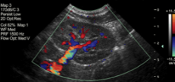
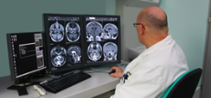
Imaging 3.0 – Beyond the Interpretation
_{Referring Physician}
_{Considers Imaging}
_{Actionable Recommendations}
_{For The Patient And}
_{Referring Physician}
Before Interpretation
After Interpretation
_{Imaging Acquisition}
_{& Interpretation}
Enhancing Image Acquisition and Interpretation
Notes:
Imaging 3.0 is our blueprint for change. It is our framework to move imaging beyond interpretation and ensure our relevance across the entire spectrum of patient care.
That is critical because a considerable amount of imaging care occurs prior to and following exam interpretation.
Most radiologists, however, do not seem to be involved across the spectrum of patient care. Most often, patients show up on our doorstep with an imaging exam order in hand. After we render the report, it’s off our radar screen, and we don’t know whether our recommendations are even followed.
If we were involved beyond the interpretation—from beginning to end—the results would be:
Improved patient safety and outcomes
More cost effective care
Increased radiologists’ relevance to the health care system
A measurable role for radiologists in improving population health
A calculation of radiology’s value in reducing per capita cost

Slide 22
How Do We Get There?
Make a cultural shift
Use evidence-based medicine to guide our practice
Empower patients to become more involved in their care
Provide a framework for IT developers to create tools physicians can use at the point of care
Align incentives
Notes:
So, how do we get there from here?
Number one is the cultural shift:
We must encourage radiologists to own all aspects of imaging.
It is critical to provide better, not more, care by delivering ALL imaging care that is necessary, safe, and beneficial and NO imaging care that is not.
Second is getting evidence-based medicine into our practices:
Clinical Decision Support is a start, but it’s only a start.
We must move forward with decision support at the point of care for referring physicians and for radiologists.
We must look for opportunities all the way through the chain where we can leverage evidence-based practice.
Next, we need to empower patients to become more involved in their care:
Radiation dose—how can we help patients understand radiation safety issues and their personal dose?
Personal health and imaging records—how can we put patients in charge of owning and sharing their own imaging records, so we don’t repeat exams?
Fourth, we must provide a framework for IT developers to create tools physicians can use at the point of care.
All of this will be the framework for IT to develop tools that physicians can use at the point of care—right from the PACS workstation.
Finally, and perhaps most important, we must align incentives:
And that means changing the discussion in Washington and with local payers as we move from volume-based care to value-based care.

Slide 23
Aligning Incentives
Policy Maker
Buy In
Public Policy Changes
Clinician
Buy In
Radiologist
Buy In
Improved Patient Care
Physicians Change Their Behavior
Courtesy Keith Dreyer, DO FACR 2013
Notes:
Under Imaging 3.0, the shift from volume-based care to value-based care sparks the need for aligned payment incentives that match this new workflow.
First, it requires buy in from radiologists, clinicians, and policy makers.
Which then drives public policy changes.
Which influences physicians to change their behavior.
Which ultimately improves patient care.
As a result, we will see a shift in incentives that align with improved quality and value.

Slide 24
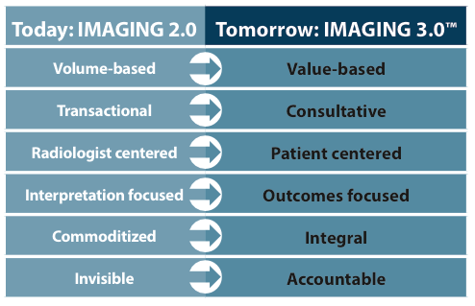
The Future Of Imaging Care
Notes:
As we make the shift from Imaging 2.0 to Imaging 3.0, here are the transformations that must occur.

Slide 25
Imaging 3.0 – Preparing for the Future
www.acr.org/Advocacy/Economics-Health-Policy/Imaging-3
Notes:
Imaging 3.0 is a:
Change process led by the ACR for the field of radiology
Set of technologies and tools that equip radiologists to ensure their key role in evolving health care delivery and payment models—and quality patient care
Call to action to all radiologists to take a leadership role in shaping America’s future health care system
For more information, visit the ACR website to find presentations and resources, discover case studies of Imaging 3.0 in action, access the Imaging 3.0 reading room, and learn about leadership opportunities.

