Slide 1
Notes for the speaker from the ACR.
This is a text-intensive PPT deck.
It was designed to be printed and handed out to attendees so that they can follow along and take more detailed notes.
Please do not feel obligated to read every word on every slide!

Slide 2
Notes for the speaker from the ACR, con’t.
This presentation is designed to be modular, so that it can be delivered in shorter segments of 10-15 minutes each:
Slide #s | Slide Content
3-4 | Introduction and Disclosures
5-9 | Background on PAMA legislation
10-19 | CDS, Imaging 3.0 and Healthcare Transformation
20-35 | Clinical Decision Support and Prior Authorization
36-45 | How Radiologists can help with CDS Implementations and Respond to Common Objections
46-54 | CDS and Private Payers
55-65 | R-SCAN and Links to Additional Resources

Slide 3

A Quick Tutorial for the Final Stretch before the PAMA deadline of Jan. 1, 2020
Clinical Decision Support for
Appropriate Ordering of Imaging
A presentation for <<forum name>> on <<August 30, 2019>>
<<Your Name>>
<<Your Day-job Title>>
<<Your ACR title(s) if you have any>>

Slide 4
Disclosures
Dr. <<your name here>> has no disclosures.
Notes:
My other disclosures are…. <if you have any>.
Or
I have no disclosures to make today.

Slide 5
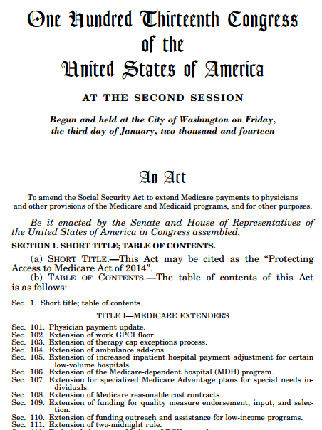
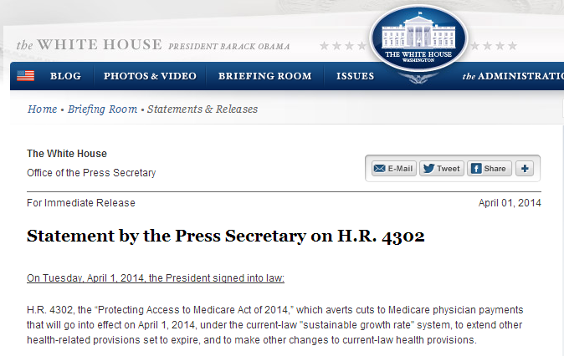
Why are we here today? PAMA of 2014
Notes:
In 2014, President Obama signed H.R. 4302 into law.
It mandated a change that for all Medicare patients needing advanced imaging care (CT, MRI, PET)
Physicians will only be paid for advanced imaging exams if the examination was ordered through an approved clinical decision support tool.
For those who don’t consult CDS, the alternative will be a new preauthorization process similar to what we have seen for years with private payers.
PAMA was a success for our patients and our specialty b/c:
It improves care by leveraging the ACR Appropriateness Criteria (AC) and its digital counterpart that can be embedded in an EHR’s ordering workflow
It kept Medicare from adopted prior authorization and radiology benefits managers for imaging
Previously, MedPAC and two presidential administrations recommended to CMS that Medicare use radiology benefits management (RBM) preauthorization (in addition to imaging cuts).
The Trump Administration is now targeting all services vulnerable to overutilization with prior authorization and outlier policies.
But because of PAMA, diagnostic imaging will not be included in these broad-based cuts.

Slide 6
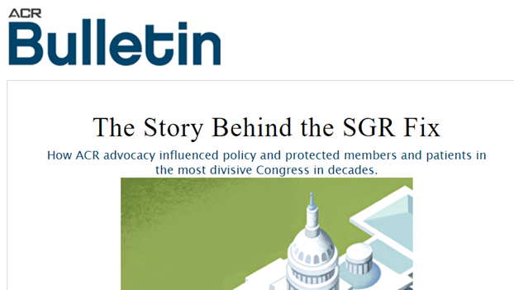
Notes:
Finally, the bill provided a permanent fix to SGR formula problem that had dogged us on Medicare reimbursement for some time.

Slide 7


You gotta be in the room where it happens.
Notes:
For a long time, we (radiologists) had been too much of the outskirts of the work that was happening in Washington and in our communities to reshape the US healthcare system.
Which is too bad, because we bring a ton of insight and value to the table.
But we hadn’t consistently communicated that value to all of the stakeholders in the US healthcare system.
PAMA was a huge milestone in radiologists getting a much bigger seat at the table.
For fans of the musical show Hamilton, PAMA helped us get in The Room Where It Happens.

Slide 8
Original Timeline
NOV 15
2015
APR 1
2016
JAN 1
2017
JAN 1
2020
Specify AUC criteria
List qCDSMs
Consultation required
Outliers identified
Notes:
The original deadline for implementation of CDS was January first of 2017.

Slide 9
Updated Timeline
Latest implementation schedule in CY 2019 Final Rule:
JULY
2018
DEC
2019
JAN
2020
JAN
2021
JAN
2023 OR 2024
Voluntary Reporting Period
-QQ Modifier
Educational
and Operations
Testing Period
Start Date
(Payment at
Risk)
Outliers
identified
Notes:
This deadline has been moved back a few times and is going now January 1st of 2020.

Slide 10
How and why did we get to this point?
Taking a step back
Why is it a good thing that we are here today?
Notes:
So let’s take a step back and answer a couple of key questions:
Why is it a good thing that we are here today?
How and why did we get to this point?

Slide 11
What is our mission as physicians?
1
Prevent sickness
2
Help sick patients get healthy as soon as possible
3
Stabilize & manage patients with chronic conditions
Notes:
You all are incredibly busy people. You work hard every day to:
Deliver great care to your patients and
Run a successful practice.
There are a number of different types of activities that compete for your time.
You don’t have time to work on them all, so you have to decide which ones are the most important, knowing that none of them are unimportant!
So why should you care about CDS? What’s in it for you? Why does it deserve your attention?
Here’s the bottom line:
We do 3 basic things in medicine: :
First - Keep people from getting sick,
Second – When they are sick, get them healthy as soon as possible
Third - When they have a chronic condition, keep their condition well managed and their quality of life high.
But the world is a complicated place and, unfortunately, we can’t just come into work every morning and just practice medicine 100% focused on our patients and getting them well.

Slide 12
The Quadruple Aims
Doing Better With Less…
Improving the work life of those who deliver care
Improving the individual experience of care
Improving the health of populations
Reducing the per capita costs of care
… Through Imaging.
Notes:
Instead we come to work every day and have to fight for our patients against larger forces that are driven by economics and the bureaucracies that grow out of those economic conditions.
But there is good news:
First, there is a lot of alignment in the US healthcare system about what changes we want to see in our healthcare systems, even if there is an absence of agreement in how we get there.
The Quadruple Aims outlined here are our guideposts. What we need is:
To improve the health of populations,
To improve our patient’s individual care experiences,
To reduce the cost per capita that we spend on care, and
To improve the work life of those who deliver care.
The second piece of good news is that:
With accountable care, we’re now being financially incented to do the right things for our patients and those paying for their care
The third piece of good news for radiologists is that:
For the entire system to succeed at accountable care and the Quadruple Aims, our healthcare system needs to use imaging as efficiently and effectively as possible. Which means we have a LOT of value to add.
And we can finally get out of this zero-sum-game thinking about carving up the limited dollars the healthcare pie.
Instead we can create a situation where we all win: Patients and their families. Healthcare systems. Referring physicians. Radiologists. Employers. And payers.

Slide 13
What is Imaging 3.0?
Imaging 3.0 is a vision and game plan for providing optimal imaging care.
“Our goal is to deliver all the imaging care that is beneficial and necessary and none that is not.”
3 Key Actions:
Culture Change
Portfolio of IT Tools
Alignment of Incentives
Notes:
So as many of you may already know, radiology as a specialty has developed our own point-of-view on how to get to the other side of healthcare transformation, and we are acting on it every day.
It’s called Imaging 3.0.
Imaging 3.0 is both the vision and game plan to achieve our goal. And our goal as radiologists, to put it succinctly, is:
To provide optimal imaging care from the moment a clinician considers ordering an imaging study or treatment
until that referring physician receives and
understands an actionable report with evidence-based recommendations.
Imaging 3.0 is about “delivering all the imaging care that is beneficial and necessary and none that is not.”
It’s the way that radiologists have been rapidly moving from volume to value.
And we’re getting there by doing three key things:
First, we’re changing the culture in radiology and the entire healthcare system.
Specifically, we’re more tightly integrating radiologists and their knowledge into healthcare delivery.
Second, we’re rolling out informatics tools like clinical decision support for the ordering of images, clinical decision support for the interpretation of images and patient data registries.
And third, as you already saw in the opening slides, we’re changing the policy conversation in Washington about how imaging is paid for.

Slide 14
The Growth of Modern Imaging (Imaging 2.0)
Technology Explosion Starts Around 1990
Imaging technologies keep improving
Imaging goes digital and is stored in PACS
Radiology interpretation is performed remotely
Demand for technology soars to new levels
Notes:
Continuing our step back to look at how we got here, the modern period of imaging (which we often call Imaging 2.0) starts around 1990.
This is when we see
CT, MRI and PET go mainstream.
Imaging goes digital and we start storing images in PACS databases.
And because of PACS, radiology interpretation starts being performed remotely.
When we put it all together, demand for imaging and radiologists to interpret those images goes way up.

Slide 15
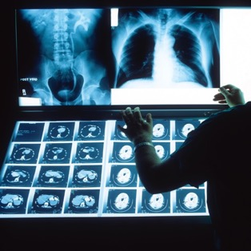


Who Wins with Imaging 2.0?
Physicians
Patients
Notes:
So there are some winners in the Imaging 2.0 era.
The biggest winners are patients and their providers who get better diagnostic tools.

Slide 16

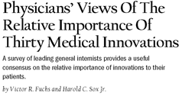
MRI and CT Scanning
Mean Response and Ranking of Physicians’ Ratings of Innovations, 2001
Rank | Innovation | Mean Score | Most | Not most or least | Least
1 | MRI and CT scanning | 0.878 | 75.6% | 24.4% | 0.0%
2 | ACE inhibitors | 0.767 | 54.2 | 44.9 | 0.9
3 | Balloon angioplasty | 0.758 | 53.8 | 44.0 | 2.2
4 | Statins | 0.736 | 48.0 | 51.1 | 0.9
5 | Mammography | 0.733 | 47.6 | 51.6 | 0.9
Notes:
Just talk to doctors who practiced medicine before CT and MRI. They’ll tell you how invaluable it is.
This is a study where internists were asked to name the most important innovations in medicine.
What you’ll see is that MRI and CT came in first place by a pretty wide margin.
Just try fighting cancer without imaging
Or when was the last time you heard someone say, “I’m having exploratory surgery because my doctor can’t figure out what’s wrong with me and has to open me up to see what’s what?”

Slide 17
Imaging 2.0: Downsides
Some level of inappropriate imaging occurs due to:
Lack of good decisions support tools
Difficulty sharing images
Defensive medicine
Misaligned incentives
+$
Healthcare spending goes way up
Notes:
But there are also some downsides to the Imaging 2.0 era
Some level of inappropriate imaging occurs due to a number of factors:
Lack of good decisions support tools,
difficulty sharing images,
defensive medicine and
Misaligned financial incentives.
And this is the same period where healthcare spending goes way up.
And imaging definitely plays a role in this until about 2006 when the growth rate for spending on imaging really starts to level off compared to other categories of healthcare spending.
Citations:
Kaiser Fact Sheet Publication (#7692-02). Trends in Health Care Costs and Spending, March 2009, http://kaiserfamilyfoundation.files.wordpress.com/2013/01/7692_02.pdf.
AJR Am J Roentgenol. 2013 Dec;201(6):1277-82. doi: 10.2214/AJR.13.10999. Comparative analysis of Medicare spending for medical imaging: sustained dramatic slowdown compared with other services. Lee DW, Duszak R Jr, Hughes DR.

Slide 18
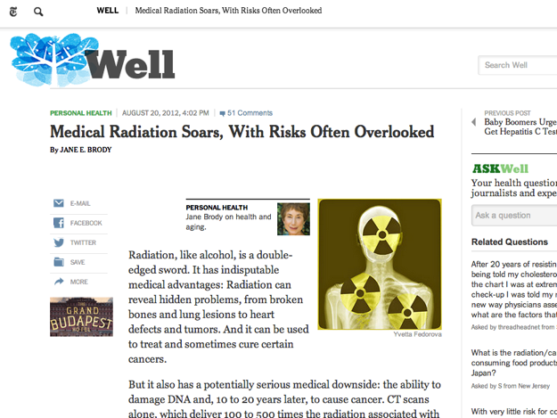
Notes:
In this period, we also start paying more attention to risks of excessive and unnecessary radiation exposure.

Slide 19

“The Invisible Radiologist”
Notes:
There’s one other important loss in this period that’s often overlooked:
When the images go digital, the radiologist’s work lists in their PACS becomes their main interface.
It’s a powerful interface, but it’s not a particularly collaborative or patient-centric.
And that face-to-face collaboration with the ordering physician in the reading room largely goes away.
Some of us become what’s known as “The Invisible Radiologist” in a basement reading room that no other doctors ever visit.

Slide 20
Every Action has an Equal and Opposite Reaction.
But the reaction is not always the most helpful one!
Prior Authorization (PA)
&
Radiology Benefits Managers (RBMs)
Total Quality Management (TQM)
vs.
Notes:
So what happens in response to the growth in imaging utilization?
We see an equal and opposite reaction: Payors implement a roadblock that’s intended to stop “runaway” imaging orders.
The fundamental issue is that while inappropriate imaging is a problem of healthcare quality and cost control is an issue as well, prior authorization is a terrible solution.
If you look at the ideas of Total Quality Management (TQM) which revolutionized business and organizations, what is says that, “When the process is broken, you don’t patch up the low-quality outputs after they roll off the factory line. You find the source of the quality problem and fix it!”
If too many inappropriate images are being ordered, then fix the way that we order the images so that doctor orders the right imaging study the first time.
Don’t spend your best energy trying to correct the order after it has been created!

Slide 21
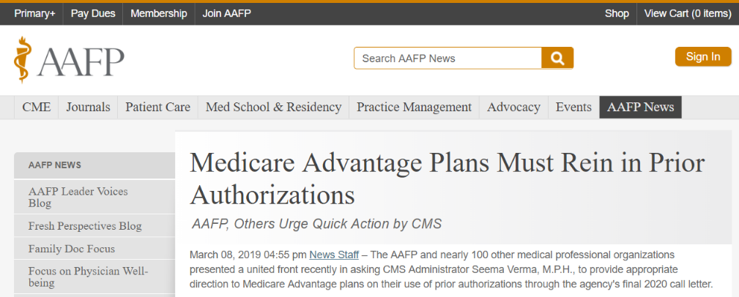
Notes:
I don’t have to show you evidence about how much everyone in the provider world (and patient world) truly hates prior authorization.

Slide 22
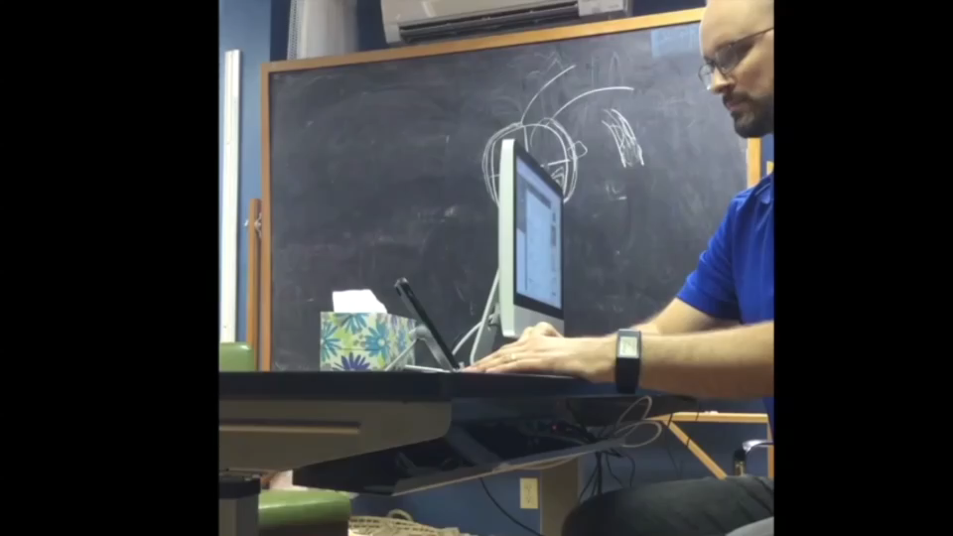
Watch the timeclock on this prior auth call!
Notes:
I know I don’t need to belabor the point of how much clinicians and patients hate prior authorization.
And there has been a lot of research done on in inordinate burden of time that this puts on the system, not to mention huge frustration for everyone involved.
But the best way to sum it up might be to show you some clips from a YouTube video posted by Dr. Ryan Neuhofel, a Family Medicine physician in Kansas.
In this video, he spends 20 minutes trying to obtain prior authorization for a CT scan for a patient who clearly needs one. Why?
Because the patient has a gross physical abnormality on his skull.
And the end result of his 20 minute call to the insurer’s RBM, which by the way contained maybe 30 seconds of clinical content, the doctor is told that they will fax him paperwork which he should fill out and send back!

Slide 23
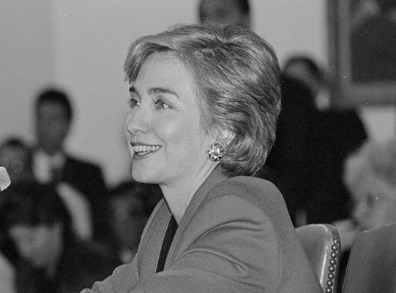
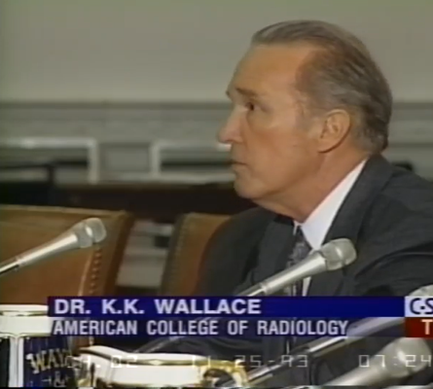
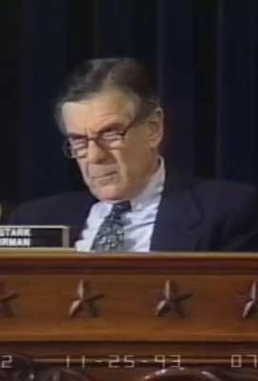
A New President and Health Care Reform
K.K. Wallace testifies for ACR before House Ways & Means
1993
Notes:
Radiology’s response to this challenge dates back to the Clinton Administration’s attempt at healthcare reform.
In response to this, the ACR tells Congress that we’re going to do our part to find a responsible solution that helps both patients and taxpayers.
We pledge that the ACR will:
Take a leadership role in defining the most cost-effective and beneficial ways of utilizing radiologic services
Design a system of patient care guidelines to eliminate inappropriate utilization of imaging services
And we follow through…. in a big way.

Slide 24
AUC History and Overview
ACR establishes the Appropriate Use Criteria Task Force in 1993
Build on best practice methods to create evidence-based guidelines built with
  Very high quality process:
    Agency for Healthcare Research and Quality (AHRQ) guidelines designed by the Institute of Medicine (now the Academy of Medicine)
  High quality scientific inputs, including combination of:
    Evidence
    Expert consensus
    Input from physicians from other medical specialties
Notes:
The ACR establishes the Appropriate Use Criteria Task Force in 1993
It Build on best practice methods to create evidence-based guidelines built with:
A very high-quality process:
Agency for Healthcare Research and Quality (AHRQ) guidelines designed by the Institute of Medicine (now the Academy of Medicine)
High quality scientific inputs, including combination of:
Evidence
Expert consensus
Input from physicians from other medical specialties

Slide 25
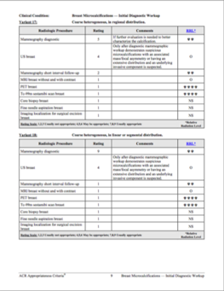
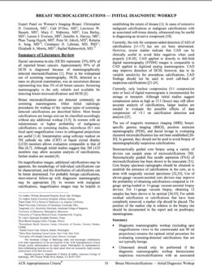
Over the Years: Delivering Clinical Decision Support To Providers
ACR Appropriateness Criteria
But Not
Widely
Used at the
Point of
Care
25 years of continuous work
Hundreds of clinical experts
Multi-specialty based
5,962 literature references
Rigorous Strength of Evidence methodology
AHRQ NGC approved
Continuously updated
Fully transparent
Widely referenced
Notes:
And they get to work creating the ACR Appropriateness Criteria
25 years of continuous work
Hundreds of clinical experts
Multi-specialty based
5,962 literature references
Rigorous SOE methodology
AHRQ NGC approved
Continuously updated
Fully transparent
Widely referenced
The problem was that these tools were not widely consulted by physicians when they actually wanted to write an order for an imaging study for the patient they were sitting with.
There were attempts to create interfaces that made it easier to consume this data at the point of care, like a little book that was a Pocket Guide for the ACR Appropriateness Criteria.
But none of these types of tools were ideal since the doctor has to stop and take the time out of their workflow to find the guide, look up the appropriate guideline, read the guideline and then figure out how it fits the presenting patient.

Slide 26


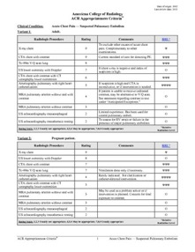


ACR Appropriateness Criteria®
Notes:
That all changed as EHR systems began to be broadly adopted.
Suddenly we could embed our clinical content directly into the EHR systems so that it could become a part of the workflow of ordering an image
Early in this decade, we started a process of converting this content from the PDF style documents you see on the right into a database of clinical content that can be integrated directly into an Electronic Health Record Ordering System.
And we also set up a national registry on the back end so that all orders are captured for reimbursement reporting to CMS, for your quality improvement work and for research at a local and national level.

Slide 27
National Adoption of CareSelect® Imaging / ACR Select ®
The preferred solution by EHR vendors has integrations with every major EHR
Generates more than 100 million decision support sessions per year
Across these transactions, the registry of transactions includes more than $4B in inappropriate imaging ⁽¹⁾
We expect the transaction numbers to rise significantly:
  Interaction with CDS becomes mandatory in 2020 for advanced imaging for Medicare
  Additional use cases such as:
    Accountable care (i.e., risk sharing) increases the imperative to order appropriate imaging
    CDS can help in the Emergency Department, where payors have dared not mandate prior authorization
    Private payor adoption of “gold card” plans where CDS supplants part or all of the prior authorization process
Over 500 healthcare organizations have adopted CareSelect Imaging
(1) Transactions scored below a 5; Calculation against MPFS
Notes:
CDS for appropriate imaging orders has seen strong growth in the time since PAMA was passed.
CareSelect® Imaging / ACR Select ® is the preferred solution by EHR vendors and has integrations with every major EHR
It generates more than 100 million decision support sessions per year
Across these transactions, the registry of transactions includes more than $4B in inappropriate imaging ⁽¹⁾
We expect these numbers to rise significantly for a few reasons:
Interaction with CDS becomes mandatory in 2020 for advanced imaging for Medicare
Additional use cases such as
Accountable care (i.e., risk sharing) increases the imperative to order appropriate imaging
CDS can help in the Emergency Department, where payors have dared not mandate prior authorization
Private payor adoption of “gold card”-type plans where CDS replaces part or all of a prior authorization process

Slide 28
Case Study on Utilization Management: Clinical Decision Support in Minnesota
$200,000,000 in Savings
60
55
50
45
HTDI Utilization Rate per 1,000 Members
40
35
ACTUAL UTILIZATION
PROJECTED UTILIZATION WITH AN UNMANAGED POPULATION
PROJECTED UTILIZATION WITH DECISION SUPPORT
30
25
1Q03
2Q03
3Q03
4Q03
1Q04
2Q04
3Q04
4Q04
1Q05
2Q05
3Q05
4Q05
1Q06
2Q06
3Q06
4Q06
1Q07
2Q07
3Q07
4Q07
1Q08
2Q08
3Q08
4Q08
1Q09
2Q09
3Q09
4Q09
1Q10
2Q10
3Q10
4Q10
1Q11
2Q11
3Q11
4Q11
1Q12
Notes:
One great case study about the use of decision support for ordering diagnostic images is from Minnesota.
This study was one of the key pieces of evidence that helped sway Congress and the President enact PAMA in 2014.
Back in 2006 they were projecting that by 2012 the MN imaging utilization rate was going to rise from just over 40 studies per 1000 members to almost 56 studies per 1000. (That’s the green line in this graph.)
But with clinical decision support, this growth was largely halted.
The yellow line in this graph is the revised projected growth with CDS.
And the yearly actuals are the blue line.
This has translated into a savings of over $200 million to payers and patients over a six year period, which doesn’t even reflect the improvements in patient care that come from skipping unnecessary imaging.

Slide 29

Case Study on Utilization Management: Aurora Health Care
The Intervention
The first large-scale (3500+ healthcare providers), randomized trial of the impact of CDS on high-cost imaging conducted by MIT researchers
Adding a CDS-driven alert for an ordering provider flagging a targeted (i.e. likely inappropriate), high-cost imaging order
Doyle J, Abraham S, Feeney L, Reimer S, Finkelstein A (2019) Clinical decision support for high-cost imaging: A randomized clinical trial. PLoS ONE 14(3): e0213373.
Notes:
Aurora Health Care in Wisconsin teamed up with a healthcare economics at MIT (who happens to be a McArthur genius fellow) to do the first large-scale (3500+ healthcare providers), randomized trial of the impact of CDS on high-cost imaging conducted.
This was an important step forward in evidence-based effectiveness research for CDS

Slide 30
Case Study on Utilization Management: Aurora Health Care
-6%
The Impact
CDS reduced those targeted imaging orders by a statistically significant 6%
Doyle J, Abraham S, Feeney L, Reimer S, Finkelstein A (2019) Clinical decision support for high-cost imaging: A randomized clinical trial. PLoS ONE 14(3): e0213373.
Notes:
What they found was that for the high-cost orders they targeted that were known to have high levels of inappropriate ordering, by using CDS to call that out to the ordering clinician in real time, they were able to reduce the inappropriate orders by 6%!

Slide 31
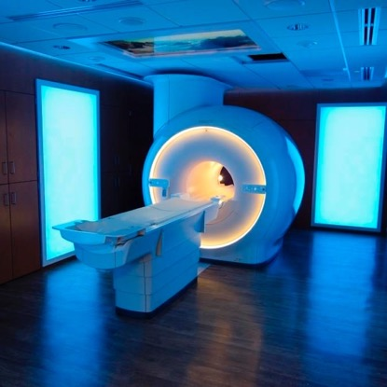
Case Study on Quality Improvement: University of Virginia
The Intervention
  In 2014, ACR Select was integrated into the electronic health record, though without displaying appropriateness scores in a “silent” mode for 6 months.
  Then, feedback regarding examination appropriateness was “turned on” at order entry for adult patients in the emergency and inpatient settings for 24 months.
  Retrospectively compared the appropriateness scores of imaging tests before and after displaying feedback at order entry and evaluated these data by modality and attending versus trainee status.
J Am Coll Radiol 2018;15:951-957

Slide 32

Case Study on Quality Improvement: University of Virginia
The Impact
After implementation of a commercially available decision support tool integrated into the electronic health record, there was a signiﬁcant improvement in imaging study appropriateness scores, more pronounced in studies ordered by trainees.
After feedback, the relative frequency of low utility studies decreased to 5.4% from 11%, and the relative frequency of indicated studies increased to 82% from 64.5%.
This was most pronounced in trainees for whom
  the percentage of low utility studies decreased from 10.8% (95% confidence interval [CI]: 10.0%, 11.7%) to 4.8% (95% CI: 4.4%, 5.2%) and
  the percentage of indicated studies increased from 65.6% (95% CI: 64.3%, 66.9%) to 83.7% (83.0%, 84.3%).
J Am Coll Radiol 2018;15:951-957

Slide 33
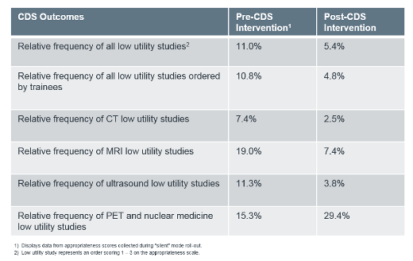
Case Study on Quality Improvement: University of Virginia
Study published in J Am Coll Radiol 2018;15:951-957 / Summary table from What UVA's experience reveals about the value of CDS, June 19, 2018 by Erin Lane and Catherine Kosse, https://www.advisory.com/research/imaging-performance-partnership/the-reading-room/2018/06/uva_cds
J Am Coll Radiol 2018;15:951-957

Slide 34

Case Study on Quality Improvement: Mount Sinai Hospital
The Intervention
Hospital implemented CDS for CT and MRI orders in the emergency department with scores based on the American College of Radiology’s Appropriateness Criteria (range, 1–9; higher scores represent more-appropriate orders).
Data on CT and MRI orders from April 2013 through June 2016 were categorized as pre-CDS or baseline, post-CDS period 1 (i.e., intervention with active feedback for scores of ≤ 4), and post-CDS period 2 (i.e., intervention with active feedback for scores of ≤ 6).
AJR 2019; 212:859–866

Slide 35
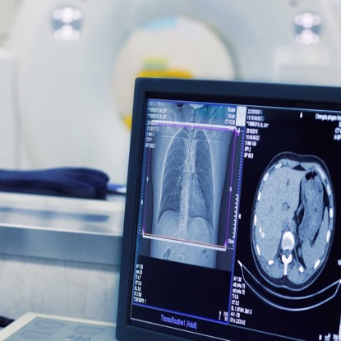
Case Study on Quality Improvement: Mount Sinai Hospital
The Impact
Implementation of active CDS increased overall scores of CT and MRI orders. (However, there was no significant difference in effect on scores between house staff)
Mean scores were 6.2, 6.2, and 6.7 in the pre-CDS, post-CDS 1, and post- CDS 2 periods, respectively (p < 0.05).
In the segmented regression analysis, mean scores significantly (p < 0.05) increased when comparing pre-CDS versus post-CDS 2 periods for both house staff (baseline increase, 0.41; 95% CI, 0.17–0.64) and non–house staff (baseline increase, 0.58; 95% CI, 0.34–0.81), showing no differences in effect between the cohorts.
The generalized linear model showed significantly higher scores, particularly in the post-CDS 2 period compared with the pre-CDS period (0.44 increase in scores; p < 0.05).
AJR 2019; 212:859–866

Slide 36
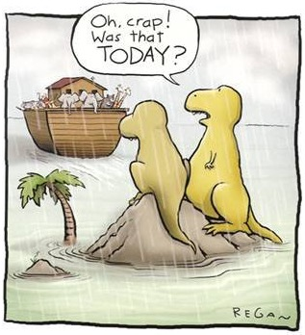
Notes:
So this is really your last chance to get on the CDS boat if you want to help drive the boat instead of just being a passenger.
CDS will go much, much better in your healthcare system if you get involved.
Frankly, you might get blamed if your referring providers don’t like it.
We want this tool to be helpful to physicians and seen as a welcome replacement to prior authorization.
And we certainly don’t want it to be seen as a new roadblock to the ordering of necessary imaging.

Slide 37

What’s in it for radiologists?
The right thing for our patients
Opportunity for leadership
In fits and spurts, the shift from volume-to-value is happening
Do well by doing good
Notes:
So what’s in this for we radiologists?
Right for the patient/care
Are you sick of reading studies that never should have been ordered or could have been so much more useful if they had been ordered differently?
Opportunity for leadership
We know so much about patient care and how the healthcare system works
Our broad view across all specialties, everyone needs diagnosis and tracking
In fits and spurts, the shift from volume-to-value is happening
Be in the room where it happens
Based on the value we bring from stepping up, be compensated for this value
“Do Well By Doing Good”
We will see the impact of that both Nationally and Locally

Slide 38

Common Objections to CDS
“The AUC program is just another example of intrusive government regulations that actually subtract value instead of adding it”
Time-consuming documentation processes for already overloaded referring physicians
More alert fatigue from the EHR
Not integrated with QPP/MACRA
Is the AUC program is more costly to administer than the potential savings it could generate?
The law is financially advantageous to the developers of the CDSMs, which house and sell the AUC tools, at the expense of clinicians who order advanced diagnostic imaging tests
All of this won’t actually result in better or more cost effective patient care
Citation: https://www.neurosurgeryblog.org/2018/01/09/unnecessary-regulatory-burden-appropriate-use-criteria-for-advanced-diagnostic-imaging/
Notes:
It’s very likely that you will hear objections to CDS from referring physicians.
And I want to be clear, there is merit to some of the points that they raise. CDS is not a silver bullet or a panacea.
Here are some of the commonly heard points:
Time-consuming documentation processes for already overloaded referring physicians
Not integrated with QPP/MACRA
Is the AUC program is more costly to administer than the potential savings it could generate?
The law is financially advantageous to the developers of the CDSMs, which house and sell the AUC tools, at the expense of clinicians who order advanced diagnostic imaging tests
All of this won’t actually result in better or more cost effective patient care
In short, critics say that the AUC program is just another example of intrusive government regulations that actually subtract value instead of adding it

Slide 39
How do we respond to common objections?
Acknowledge the critique
CDS is not a magic bullet. There are no magic bullets in healthcare.
But CDS can help you and your patients
Notes:
So the response to this is actually pretty simple.
First, you can acknowledge the critique. While reasonable people can disagree, the critics to raise some reasonable points.
But rather than reply to those objections line by line, it might be more effective to say:
CDS is not a magic bullet. There are no magic bullets in healthcare.
But CDS can help you and your patients. The process for ordering images is broken and everyone knows it.

Slide 40
How do we respond to common objections?
“Democracy is the worst form of government,
except for all those other forms that have been tried.”
Sir Winston Churchill
At a bare minimum, CDS is better than the alternatives
Would an ordering physician rather add a few clicks to his/her workflow or wait on the phone for extended periods of time to speak to an “expert” at an RBM?
Notes:
So we can add a few clicks to your EHR workflow, or you can start handling prior authorization calls for all of your Medicare patients.
Because that’s where things were headed before the ACR stepped in to propose CDS as an alternative to prior authorization.
It’s sort of like the old expression, “Democracy is the worst form of government, except for all those other forms that have been tried.”

Slide 41
How do we respond to common objections?
Gives you a tool to communicate with a patient why an order they want is inappropriate.
With very few minutes to allocate to each patient, it’s easy to just do the order, which we know is not necessarily the right thing
Stop getting dinged on patient satisfaction surveys (and compensation) for doing the right thing!
Notes:
Also, we all have patients who really want a scan, even though you know there is no benefit to it, and maybe even some hard.
CDS gives you a tool to communicate with a patient why an order they want is inappropriate.
And maybe then you can stop getting dinged on patient satisfaction survey (and compensation) for doing the right thing!

Slide 42
How do we respond to common objections?
Clinical documentation of appropriateness as an alterative to defensive medicine
Why patients should not have a head CT for mild traumatic brain injury
Notes:
Also, clinical documentation of appropriateness is an alternative to defensive medicine.
If the EHR documents that it advised you not to order the head CT for the patient who bumped their head but has no symptoms, then that’s something that can help you in a malpractice suit.
And I should note that there is an exception to consulting CDS in the case of an emergent case, so CDS will not stand in the way of physician judgement in situation where there is literally no time to waste in diagnosis.

Slide 43
How do we respond to common objections?
Plus… We can make imaging much more effective (which is why we went into medicine in the first place)
We have an extensive, high-quality base of evidence on what is the best study to order when.
Let’s use it to…
  Figure out sooner what’s going on with our patients
  Use healthcare resources and dollars on the things that have impact!
Notes:
We have an extensive, high-quality base of evidence on what is the best study to order when… let’s use it to…
Then we can figure out what’s going on with our patients sooner and help them get better.
Isn’t that why we all went into medicine in the first place?

Slide 44
How can radiologists ease adoption for referring physicians?
The world is run by those who show up!
Listen to their concerns, work through their issues and generally be a partner
Plan an optimal rollout
Develop a communications and change management plan (mass outreach and one-on-one)
  Like anything in informatics and healthcare quality, CDS is a just a tool. Change management and communication are how we make the tool a success.
All healthcare is local
  Customize the tools, EHR workflow and logic to meet local needs
CMS reporting
Notes:
So how can we step up?
How can radiologists can ease adoption for referring physicians?
The answer isn’t rocket science. It just takes good, patient work.
Basically, the world is run by those who show up!
Listen to their concerns, work through their issues and generally be a partner!
Plan optimal rollout
Communications plan (mass and one-on-one)
All healthcare is local!
Customize the tools, EHR workflow and logic to meet local needs
Help with CMS reporting to make sure it goes smoothly

Slide 45
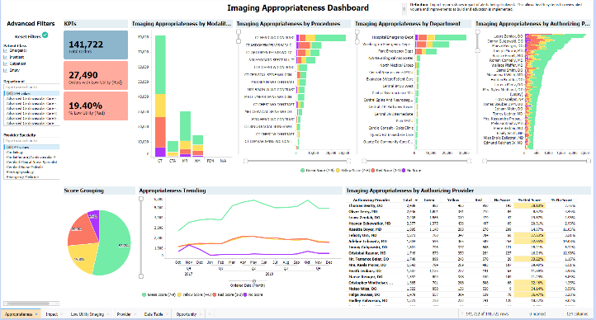
How can radiologists can ease adoption for referring physicians?
De-identified report courtesy of Grand Traverse Radiology.
Notes:
This is an example of a QI dashboard that a radiology practice put together to help them work with ordering providers to improve the appropriateness of their imaging.

Slide 46

The Next CDS Frontier is Private Payers: Five Variations of CDS supplanting Prior Authorization
Gold Card with No Notification
Providers ordering with CareSelect Imaging are excluded from prior authorization requirements with no reporting requirements. This is usually when the health system or physician group is 100% at risk.
Notes:
So after Medicare, the next big frontier for CDS is when providers and other payers like Blue Cross, Aetna and state Medicaid programs enter into arrangements where CDS can supplant prior authorization as the way to control utilization and improve healthcare outcomes.
There’s a number of different flavors of these collaborations that we’ve seen.
The first version of this is “Gold Card with no Notification” for situations when the providers are 100% at risk. In those cases, the payers basically know the providers are using CDS and trust them to do the right thing with appropriate imaging b/c it’s clearly in their financial self interest.
The common denominator between the next 4 variants is that the providers regularly share data with the payors on how its going so that they payers see demonstrated ROI and value from the use of CDS. And that sharing of data also puts a very healthy accountability on the providers that drives behaviors that help our patients in the end by aligning incentives to ensure appropriate imaging for our patients.

Slide 47
The Next CDS Frontier is Private Payers: Five Variations of CDS supplanting Prior Authorization
Gold Card with Reporting Requirements
Providers ordering with CareSelect Imaging are excluded from prior authorization requirements. The health system shares CDS metrics with the health plan.
The Wisconsin Medicaid (BadgerCare) Radiology Imaging Exemption for CT and MRI uses this approach.
Some of the data that may be shared included the distribution of orders by utility range (%) and percentage of orders that did not receive a score metrics to the health plan.
In other cases, the health system shares detailed order and appropriate score information at a order level. Some groups include the Clinical Decision Support Number (CDSN) as a proxy for the authorization number on claims. We can embed the appropriateness score (0-9) in the CDSN so the payer can know the score of the imaging exam as part of the claims process.
Notes:
The second variant is “ Gold Card with Reporting Requirements.” In this case, as long as a provider consults CDS, they can bypass any prior authorization. They do share data about this with the payers.

Slide 48
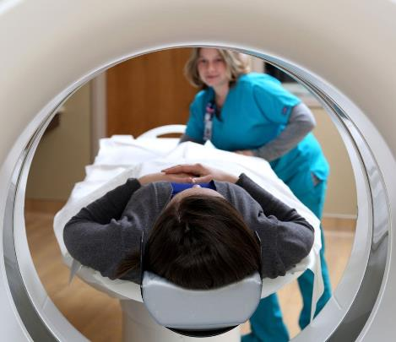
The Next CDS Frontier is Private Payers: Five Variations of CDS supplanting Prior Authorization
Approved
Appro. Score
Standard authorization process required
Gold Card with Threshold
For providers ordering with CareSelect Imaging, if the appropriateness score is high enough, the referral is auto-approved with no notification to the payer. If the score is below a threshold, then the standard authorization process is required. The health system shares CDS metrics with the health plan.
Notes:
The third variant is “Gold card with threshold” where orders are auto approved if the CDS indicates that the exam meets a certain level of approiratness. If the order does not, then the order enters the Prior Authorization process.

Slide 49

The Next CDS Frontier is Private Payers: Five Variations of CDS supplanting Prior Authorization
1
Notification:
Order for image study
Notifications for all Services
Payers require notification for services often via the existing portal but will not deny services via authorization. Health system may be required to include the Notification number on claims. The health system shares CDS metrics with the health plan.
Notes:
In the fourth variant, the provider still has to notify the provider that they are issuing and order for an imaging study, but the provide will let that sail through as long as the CDS consult is properly documented.

Slide 50

The Next CDS Frontier is Private Payers: Five Variations of CDS supplanting Prior Authorization
Implementing an electronic prior authorization program around the CDS
Providers send the appropriateness score on the authorization request for accelerated approval or reduction in the required clinical documentation. Workflow is implemented using a 278R with the appropriateness score (0-9) in an agreed upon field. The payer or RBM automatically approves the authorization or requests addl. clinical information depending on score and study. The health system shares CDS metrics with the health plan.
Notes:
In the 5th and final version, CDS basically becomes part of the prior authorization process, but a CDS order that is properly done should be auto approved or the back-and-forth process to get follow-up information is streamlined so that it takes less effort on the part of the provider and the approval happens on a much faster timeline than traditional prior authorization.

Slide 51
Early CDS Collaborations between Private Payors and Providers
DuPont Medical Center
Mid-sized academic health system with affiliated health plan, Logan Health Plan
DuPont plans to share CDS data with Logan Health Plan to demonstrate imaging utilization management and negotiate to bypass preauthorization
DuPont will then bring data from that partnership to other commercial payers in order to negotiate similar contracts
Virginia Mason Medical Center
336-bed acute care hospital with 460-physician employed medical group based in Seattle, Washington
Virginia Mason gathered input from commercial payers early in their CDS planning stages to gain buy-in and focus on the highest-value exams
In 2005, leaders selected first CDS targets; providers could not order against guidelines without consulting a member of the multidisciplinary team that created and vetted guidelines
Virginia Mason now requires providers to use CDS for all advanced imaging exams for all payers, except for certain low-volume specialty studies, particularly studies designed for preoperative planning
From The Advisory Board’s Imaging Performance Partnership’s Playbook for Implementing Clinical Decision Support, 2015.
Notes:
These are two early case studies of CDS collaborations between providers and payers: DuPont Medical Center and Virginia Mason medical Center
One common denominator for both of these is that there was a pilot project with a single payer, and once they built up data showing the ROI of CDS, they were able negotiate similar deals with additional private payers.

Slide 52
Case Study on Accountable Care: Brigham and Women’s Hospital (Partners Healthcare) & Blue Cross
The Intervention
Payer
Data
The provider proposed to payer that instead of using prior authorization with a radiology benefits management firm, they could better manage utilization with Clinical Decision Support
The provider and payer agreed to a shared risk/shared reward arrangement.
Provider data is continually shared with the payer, and this data was used to negotiate similar contracts with other commercial payers.
Data
Data used to negotiate similar contracts with other commercial payers.
The American Journal of Medicine (2013) 126, 687-692
Notes:
In Massachusetts, Brigham and Women’s Hospital had been approached by Blue Cross about implementing prior authorization for imaging. They already had CDS in place at the time and were able to shift the conversation to a CDS-based solution, which has worked very well.
Brigham and Women’s even shares some of the savings not just with Blue Cross, but also with the ordering physicians. So it’s a win-win-win for everyone involved.

Slide 53
Case Study on Accountable Care: Brigham and Women’s Hospital (Partners Healthcare) & Blue Cross
The Impact
12%
In 1.8 million patient-months from January 2004 to December 2009, there was a 12.0% sustained reduction in high-cost imaging intensity over the 5-year period (P < .001).
The number of CT studies performed decreased from 17.5 per 1000 patient-months to 14.5 (P < .01)
Nuclear cardiology examinations decreased from 2.4 to 1.4 (P < .01) per 1000 patient-months.
The MRI rate remained unchanged at 11 studies per 1000 patient-months.
sustained reduction in high-cost imaging intensity over the 5-year period
The American Journal of Medicine (2013) 126, 687-692
Notes:
What they found over a 5 year period is that there was a 12% sustained reduction in high-cost imaging intensity over the 5-year period.

Slide 54


Early CDS Collaborations between Private Payors and Providers, con’t
BCBS of Massachusetts and Brigham and Women’s Hospital
1. BWH approaches payer about using CDS instead of requiring preauthorization
2. BWH and payer develop shared savings contract that allows providers to bypass preauthorization
“The payer did not just ‘give us a pass,’ but we had a financial incentive to reduce high-cost imaging utilization at the Brigham. Some of those dollars actually got distributed to individual ordering providers.”
BWH leverages data to negotiate contracts with other payers
4. BWH monitors imaging utilization and shares data with payer to demonstrate success of CDS
3. BWH incentivizes ordering clinicians to use CDS by sharing savings
Dr. Ramin Khorasani,
Brigham and Women’s Hospital
From The Advisory Board’s Imaging Performance Partnership’s Playbook for Implementing Clinical Decision Support, 2015.
Notes:
We don’t need to look at this now, but the Advisory Board put together this great diagram to illustrate how this all worked.

Slide 55



An Imaging 3.0 Case Study - July 31, 2018
Ahead of the Curve
Early adopters of Clinical Decision Support deliver more appropriate imaging and help ordering physicians prepare for PAMA legislation’s impact on reimbursement.
These slides are disseminated to our respective members as a partnership of:
Notes:
So here’s a case study of a successful CDS implementation.

Slide 56

If you experience troubles playing the video, please copy and paste the following URL into your browser: https://www.youtube.com/watch?v=kirrgYcl6Ro&feature=youtu.be
CDS Case Study Video
Notes:
Watch the video

Slide 57

Case Study Overview: An ACR Imaging 3.0 Case Study
Alignment
Radiology leadership saw CDS as a way to improve the quality of imaging ordering, as well as prepare for future reimbursement requirements (i.e., PAMA)
Socialization with Key Stakeholders
Radiology leadership approached leaders of other specialties at the hospital, like ED, to see if they would take part in the pilot.
Iterative Pilot Testing
Prepared video to help explain CDS to new recruits
After a first round of testing, expanded to more departments and more physicians within each department
Review data on appropriate ordering before and after
Solicit and Incorporate Feedback
Collaborated with vendor of CareSelect to incorporate PECARN guidelines as a supplement to AC guidelines in CDS system
Ryan K. Lee, MD, MBA, section chief of neuroradiology, is spearheading an incremental pilot project to integrate CDS into the EMR at Einstein Healthcare Network in Philadelphia.

Slide 58
Discussion Topics for Your Team
1
Who is driving the CDS rollout in your organization ahead of the 2020 PAMA deadline? Are there radiologists involved in or leading the team? Why or why not?
2
Will your organization’s CDS rollout happen in stages, obtaining buy-in and feedback to be incorporated at each stage?
3
What clinical guidelines are the highest priority for your ordering physicians? Based on the data, where is the potentially biggest impact from CDS on ordering habits?
4
What could impede the success of your organization’s CDS rollout? How can those risks be mitigated?

Slide 59


How can radiologists ease adoption for referring physicians
R-SCAN™ (Radiology Support, Communication and Alignment Network) is a collaborative action plan that brings together radiologists and referring clinicians to improve imaging appropriateness.
R-SCAN delivers immediate access to web-based tools and clinical decision support technology to help you optimize imaging care.
R-SCAN is funded through a CMS Transforming Clinical Practice Initiative grant awarded to the American College of Radiology.
Radiologists who play a meaningful role in R-SCAN can claim MOC Part 4 credit.
For many topics, referring clinicians can earn CME credits and radiologists can earn SA-CME credits.

Slide 60

CT for Recurrent Renal Colic - Avoid ordering CT of the abdomen emergency department (ED) patients (age <50) with known histories of kidney stones, or urolithiasis, presenting with symptoms consistent with acute uncomplicated renal colic.
CTA for Asymptomatic Patient at Low Risk for Coronary Heart Disease - Don’t routinely order coronary computed tomography angiography for screening asymptomatic individuals.
Admission and Pre-op Chest X-ray - Avoid admission or preoperative chest x-rays for ambulatory patients with unremarkable history and physical exam.
CTA for Pulmonary Embolism - Do not perform chest CT angiography to evaluate for possible pulmonary embolism in patients with a low clinical probability and negative results of a highly sensitive D-dimer assay.
Adnexal Cyst Follow Up - Do not recommend follow-up imaging for clinically inconsequential adnexal cysts.
Advanced Imaging for Early Prostate Cancer Staging - Don’t perform PET, CT, and radionuclide bone scans in the staging of early prostate cancer at low risk for metastasis.
Imaging for Low Back Pain
Don’t perform advanced imaging (eg, MRI) of the spine within the first 6 weeks in patients with nonspecific acute low back pain in the absence of red flags.
Notes:
R-SCAN has content based on a number of Choosing Wisely topics related to appropriate imaging.

Slide 61
CT for Uncomplicated Rhinosinusitis
Don’t order sinus CT or indiscriminately prescribe antibiotics for uncomplicated acute rhinosinusitis.
Imaging for Uncomplicated Headaches
Don’t do imaging for uncomplicated headache.
CT for Minor Pediatric Head Injury
CT scans are not necessary in the immediate evaluation of minor head injuries; clinical observation / Pediatric Emergency Care Applied Research Network criteria should be used to determine whether imaging is indicated.
CT for Adult Minor Head Trauma
Avoid computer tomography (CT) scans of the head in emergency department patients with minor head injury who are at low risk based on validated decision rules.
Advanced Imaging for Pediatric Febrile Seizures
Neuroimaging (CT, MRI) is not necessary in a child with simple febrile seizure.
Incidental Thyroid Nodule Follow-up
Don't recommend ultrasound for incidental thyroid nodule in low-risk patients unless the nodule meets age-based size criteria or has suspicious features.

Slide 62






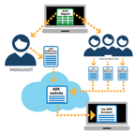



1
Pledge to Join R-SCAN
2
Select the Choosing Wisely Topic
3
Identify Collaborators + Register for R-SCAN
4
Case Identification
5
Rate the Cases
+ Review the Reports
6
Carry out the Educational Plan
7
Case Identification
8
Rate the Cases
+ Review the Reports
9
Complete the Final Report
10
11
Share your story!
Choose your next topic.

Slide 63

R-SCAN Case Study Video
If you experience troubles playing the video, please copy and paste the following URL into your browser: https://youtu.be/wTukDDCN3ww

Slide 64

Case Study Overview: An ACR Imaging 3.0 Case Study
Alignment
Approached the local health system to collaborate on R-SCAN
Engaged key physicians to utilize R-SCAN’s free clinical decision support tool to reduce unnecessary imaging exams and prepare for upcoming government regulations.
Thoughtful Implementation
Took a random sample of patients and then compare image ordering data against R-SCAN’s ACR Select CDS tool to find the physicians who were considered outliers (in terms of ordering patterns that reflected unnecessary imaging.)
Reach out to those providers
Content Localization
Asheville Radiology was the first radiology group to customize its own R-SCAN topic in order to focus on the unique needs of its rural community, making it easier for referring physicians to participate.
Bryon A. Dickerson, MD, president and executive medical director of Asheville Radiology Associates, and his colleagues have sought to reduce inappropriate imaging and improved quality through their innovative use of R-SCAN.

Slide 65

Additional Resources
ACR Resources for Clinical Decision Support | ACRSelect / CareSelect imaging | R-SCAN
https://www.acr.org/Clinical-Resources/Clinical-Decision-Support | http://nationaldecisionsupport.com/acrselect/ | https://rscan.org/
Notes:
Here are links to additional resources from the ACR on the topics we’ve discussed today.

Slide 66
Q&A

